Slide 1


Virtual Training
Fleet Management Information System (FMIS)
Automobile Use Tracking On-Line System (AUTOS)

Slide 2
Table of Contents
Getting Started
Accessing AUTOS / Logging In
Reset Password
My Vehicles
  Manage Vehicles
Add Vehicle Contacts
Magic Bar / Flagged Data Elements
  Odometer
  Separated Contact
  AIE – Agency Incurred Expenses
  Address Clean Up
  Missing Assignment Type
  Missing Vehicle Contact
  Missing Tag
  Open Recalls
  Accidents
  Expired Tag
  Billed After Disposal

Slide 3

For Assistance (Contact Us)
For general system/login ID/password issues:
  support@netdigitalsolutions.com
OASAM BOC Fleet Management Program
  zzPPMO-FleetManagement@dol.gov
  cevasco.joseph.a@dol.gov
  butler.brianna.k@dol.gov

Slide 4
Why is maintaining AUTOS and GSAFleet.gov is important?
  AUTOS gathers data from GSA and other sources to alert to any potential data issues.
  Logging in monthly keeps information current and accurate.
  Reduces workload at the end of the year for FAST submission (Federal Automotive Statistical Tool).

Slide 6
Why Maintaining AUTOS and GSA are important to DOL Fleet Mission
GSA
AUTOS
Ensure Mileage is accurate for billing purposes
Logging in monthly to ensure all data has been entered and is accurate to the best of your knowledge.
Ensure FAST
Federal Mandate for each governmental agency to have a Fleet Management Information system
Easily capture data for data calls requested by DOL Leadership or above.
Easily audit the information that GSA provides

Slide 7
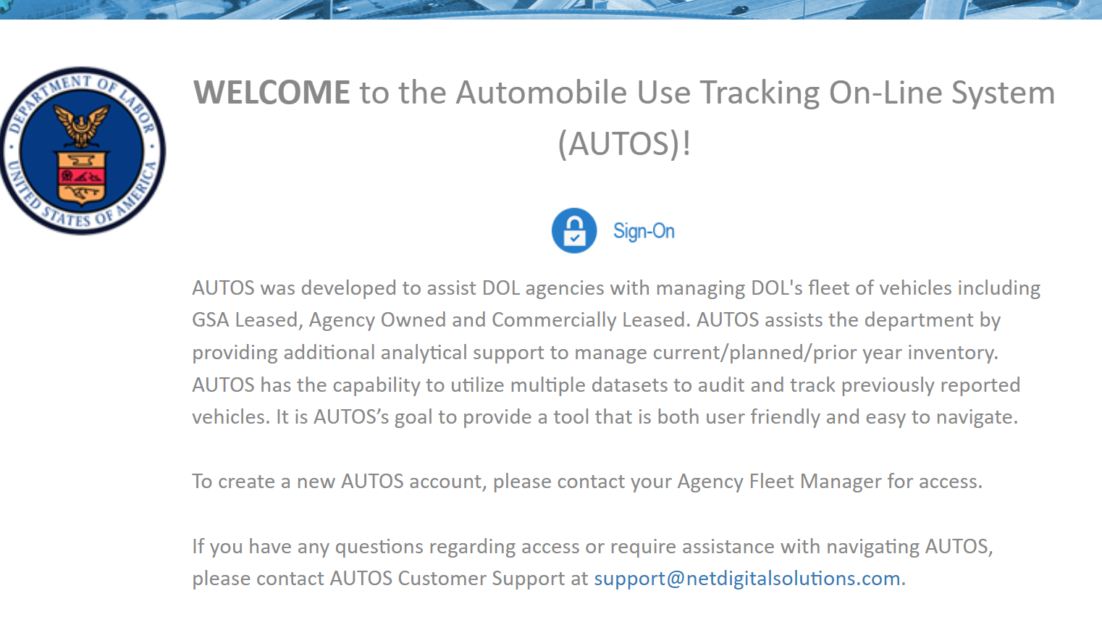
Logging in & Access to AUTOS
URL: https://autosv5.netdigitalsolutions.com
  Click on the Blue and White Sign-On Icon
  Please note that if you are logging in for the first time, you should reach out to your DOL Agency Fleet Manager to create your user account.
  NOTE: DOL may send password reset emails to junk/clutter or quarantine.

Slide 8
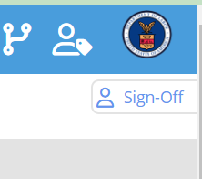
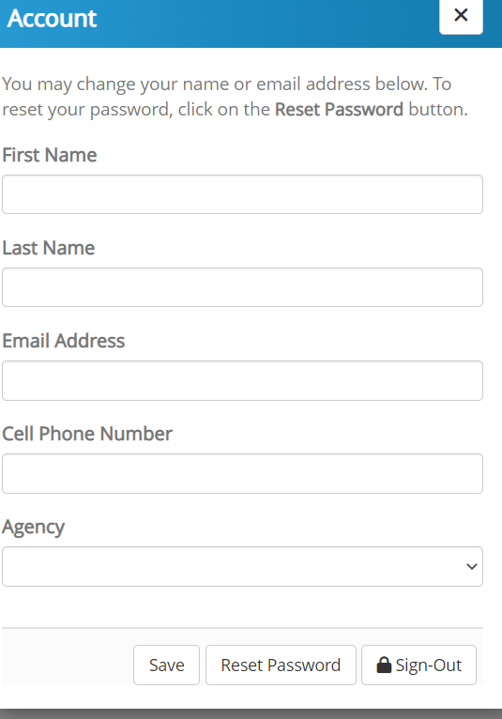
Reset Password
To change the password you were provided, Click on the "Sign-Off" icon in the upper right corner.
A pop up should appear like the one below. Then click "Reset Password". You will receive a link in your email to complete the process.
NOTE: Based on user feedback, a new feature called "My Profile" will house this feature and many more in a future update!

Slide 9
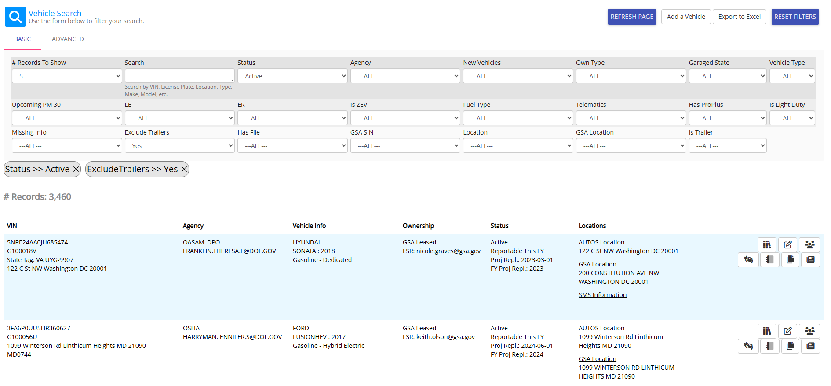
My Vehicles
"My Vehicles" is a designated location to view, edit, and manage your vehicles at a glance.
DOL’s fleet managers can view all the vehicles in their agency.
Vehicle Contacts will only see their local vehicles.
Click on the person icon to the right to add Additional POCs to help distribute the workload.

Slide 10

My Vehicles- Common Question
What if I don’t see a vehicle I know is mine?
GSA leased vehicles will have the GSA listed contact as the primary POC automatically.
Reach out to your Fleet Manager or the primary contact to assign you to the vehicle as well.
For Agency Owned vehicles, please contact your DOL Fleet Manager.

Slide 11

Manage My Vehicles
"My Vehicles" allows users to view all pertinent vehicle info with a click.
Circled here is "SMS" (Space Management System) information.
This will show building information as it relates to DOL's Real Property Portfolio.

Slide 12
Manage My Vehicles- Telematics
"My Vehicles" allows users to view all pertinent vehicle info with a click.
Circled here is "Telematics Info".
If the vehicle has telematics installed, reported mileage will be displayed here.

Slide 13
Manage My Vehicles- Vehicle Research
"My Vehicles" allows users to view all pertinent vehicle info with a click.
Circled here is "Vehicle Research".
This is a deep dive on the historical vehicle information.
Excellent tool for when you have a question about a GSA Disposed vehicle.

Slide 14
Manage My Vehicles- Odometer
"My Vehicles" allows users to view all pertinent vehicle info with a click.
Circled here is "Odometer"
  This feature is undergoing construction.
  Upon completion it will take you directly to the odometer record for that particular vehicle.

Slide 15
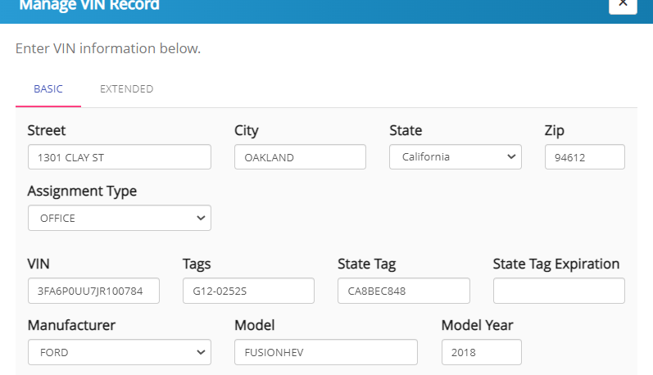
Manage My Vehicles- Edit
Circled here is "Edit".
Over the life of the vehicle, the user may need to update the address, or tag information.
  Note: JCC does not have any LE, ER, or ARM vehicles.

Slide 16
Manage My Vehicles- Change Address
Circled here is "Edit".
In order to change the address, carefully type the garaged location of the vehicle.
Take care to hit “SAVE” at the bottom of the screen before exiting.

Slide 17
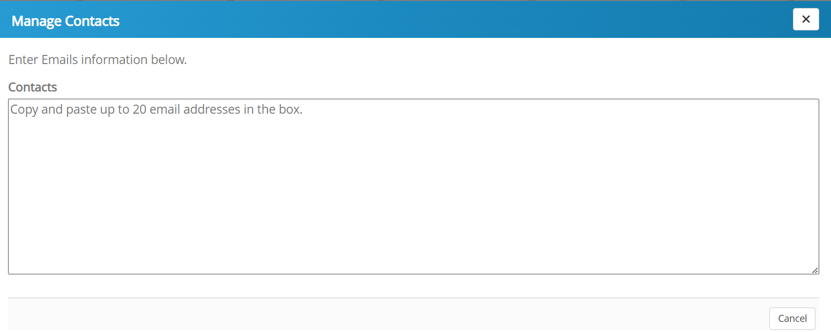
Manage My Vehicles- Vehicle Contacts
Circled here is "Manage Vehicle Contacts".
Add any contacts who you wish to help you with your responsibilities

Slide 18
Manage My Vehicles- Accidents
"My Vehicles" allows users to view all pertinent vehicle info with a click.
Circled here is "Accident".
Review any pertinent information from the GSA Bill.

Slide 19
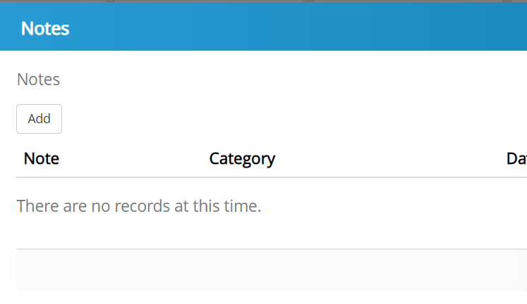
Manage My Vehicles-- Notes
Circled here is "Notes".
Add any notes you wish to communicate for future reference or for your team to see.

Slide 20
Manage My Vehicles-- Files
Circled here is "Files"
Upload any necessary files that you want to be attached to this vehicle record.
All GSA vehicles are required to upload 1152 documents.
Utilize the file button to create a historical record for each vehicle.

Slide 21
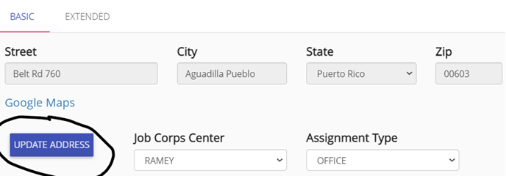
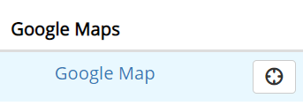
Request Address/Change Address
The purpose of this feature is to ensure that addresses are standardized and synchronized with DOL.
You will see the current address and a button underneath "Update Address".
"Update Address" will bring up a page for searching for a list of approved DOL addresses.
Be sure to put in the garaged address. The physical location of the vehicle. Garaged Addresses CANNOT be suite numbers or P.O. Boxes.
If the address is not in the system already, you will need to "REQUEST ADDRESS ADDITION".

Slide 22
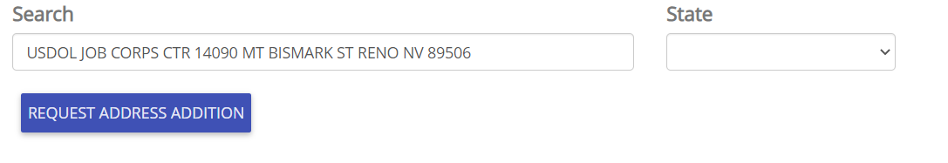
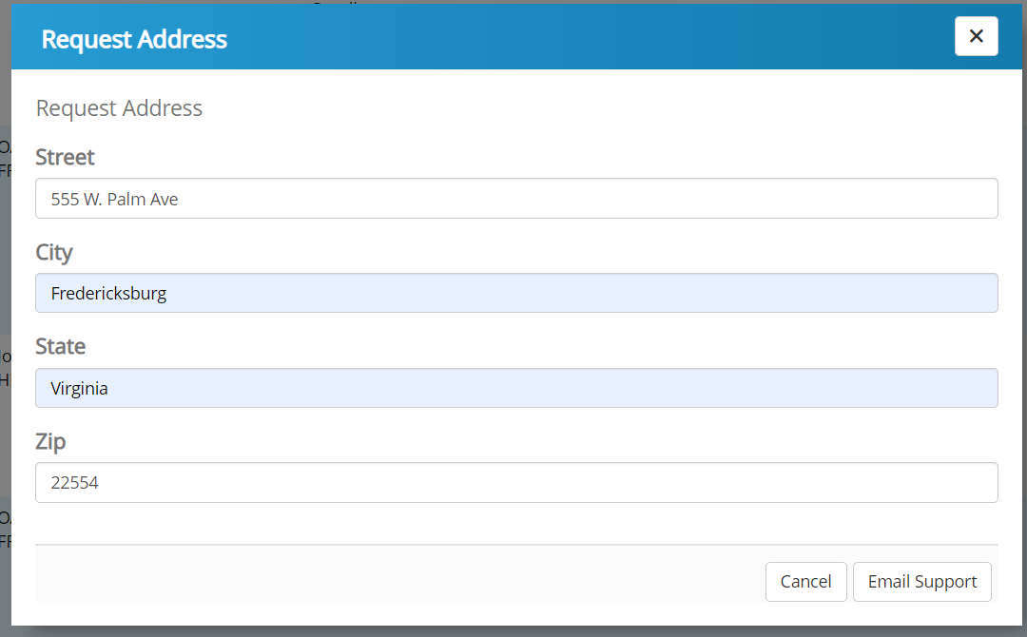
Request Address/Change Address
Complete the form with the Garaged Address.
Click "Email Support" to complete the process
The new location will be reviewed by HQ

Slide 23
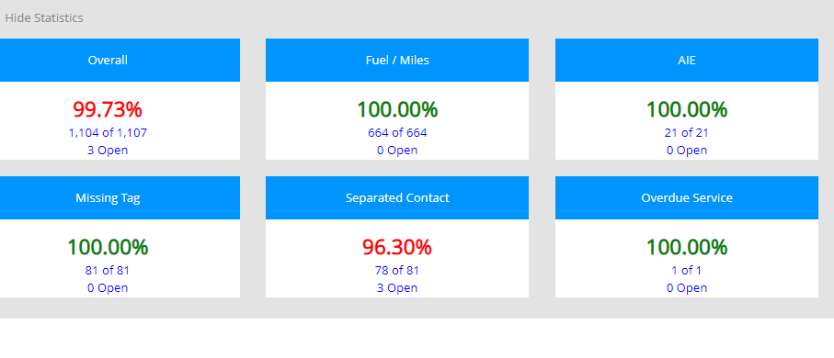
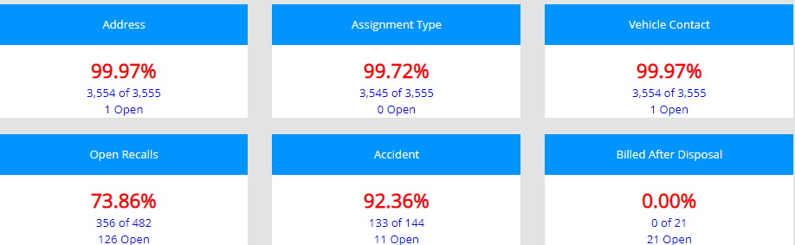
Magic Bar/Flagged Data Elements- Dashboard
The Dashboard is an overview of critical data categories.
Ensures that no critical data fields are missing.
The data comes in monthly from GSA but is 1 month behind.
Agency Fleet Managers will see their entire agency fleet's progress.
As a vehicle contact, you will see only your progress for your assigned vehicles.
The goal is to get each category to 100% green!

Slide 24
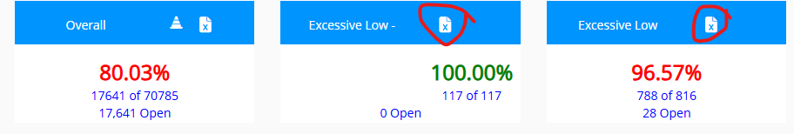
Magic Bar/Flagged Data Elements- Dashboard
The grey bar expands or hides your MAGIC Bar/Dashboard.
Be sure to expand the magic bar to review the data the needs to be completed.
Click on that element to get a look at the specific fields required.
You may also export to excel by clicking the paper icon in the top right of the category.

Slide 25
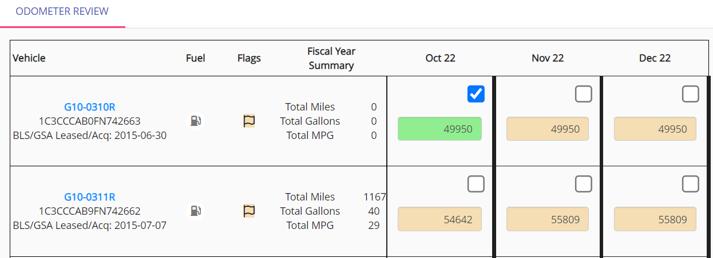
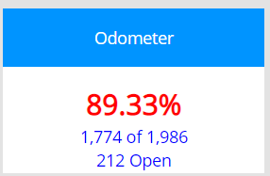
Odometer
NDS receives this data from GSA monthly. The data shown will be for the prior month.
When you click certify/verify, you are confirming that the information that came over from GSA is correct.
Click the check box when done!
The system will flag negative odometer miles or excessive miles.
Review to ensure the ENDING Odometer Reading is correct.
  Quick Tips:
    ANY vehicle that was in the inventory in the current fiscal year will be required for review.
    Vehicles that are disposed with show a grey box and a disposal date.

Slide 26

Miles Review
A vehicle will have a yellow flag appear when there may be an issue with data consistency.
A flag helps users see a potential problem.
Some examples include:
  3 consecutive months with no fuel, gallons, or miles
  High Miles Per Gallon (MPG)
  High mileage
  Or any other anomalies that need further review.
If the information is correct, simply click the check button.
If the information is inaccurate, please update

Slide 27
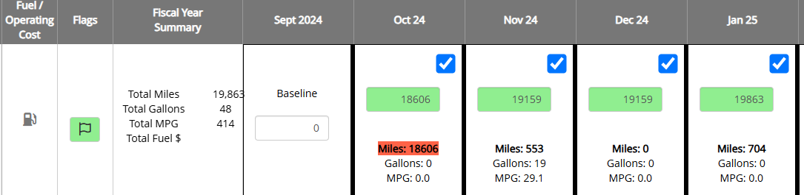
Miles Review- FAST Concerns
For Example: Here the Red Highlighted Mileage indicates that there is an issue.
The Baseline reads zero, but the vehicle odometer reads 18,606 in October. The vehicle could not have driven 18k miles in one month, so please fill out the odometer reading for the month of September to resolve the error.

Slide 28
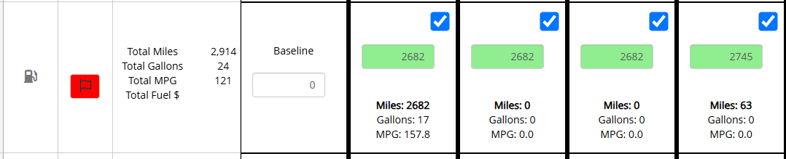
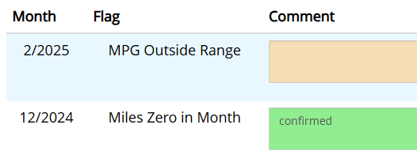
Miles Review- FAST Concerns
For Example: The flag is highlighted RED. Please click on the flag to bring up the concerns and resolve.
You see that the MPG is flagged. The vehicle was driven 2,682 miles but only purchased 17 gallons of fuel.
This is misaligned with the Vehicle’s Miles Per Gallon per the manufacturer.
When this occurs, the user will need to either add fuel or correct mileage.
To resolve, we need to adjust the baseline reading to the include odometer reading for Sept 2024.

Slide 29
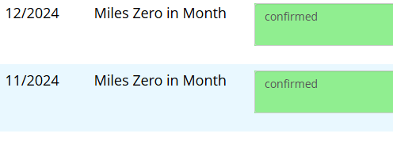
Miles Review- HQ Concerns
You may also get a flag if your vehicle has driven 0 miles in a given month.
Please provide an accurate reason for why this vehicle was not utilized.
Excessively Low utilization may require the vehicle to be turned in. ***
Confirmed is not a valid response.
Example:
Vehicle in Shop- Waiting on part
Vehicle in Accident
Vehicle driven but not fueled
Vehicle not needed for mission

Slide 30

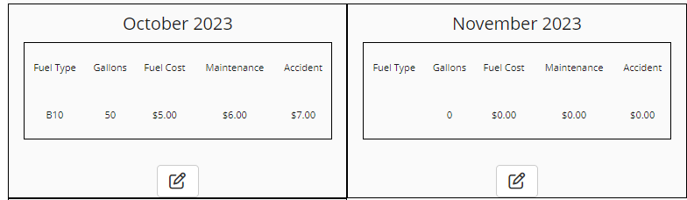
Operational Cost for Agency Owned
For FY24, our mission is to gather as much accurate information on agency owned operational costs prior to our FAST Submission.

Slide 31
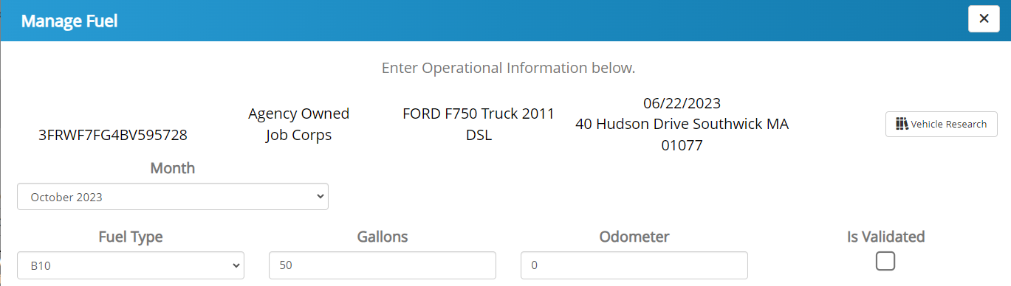
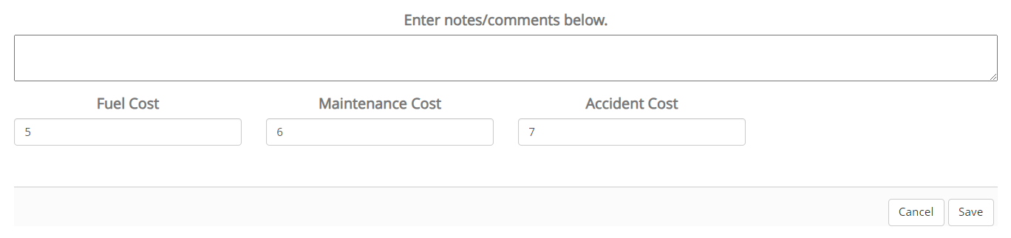
Operational Cost for Agency Owned
If there is no operational costs for that particular month, be sure to enter a comment explaining why.

Slide 32
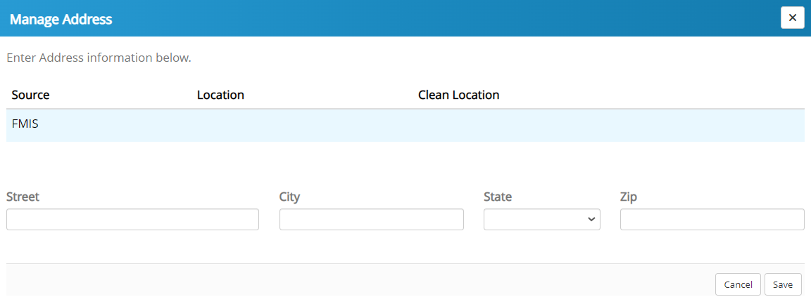
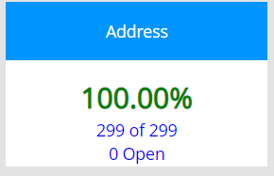
Missing Address
The garaged address is required for FAST submission
A suggested address will populate, if one exists.
Either confirm the suggested address or
Type in a new address with extra attention to detail

Slide 33
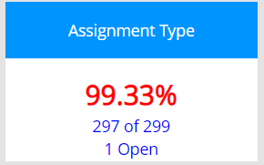
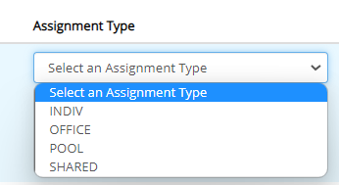
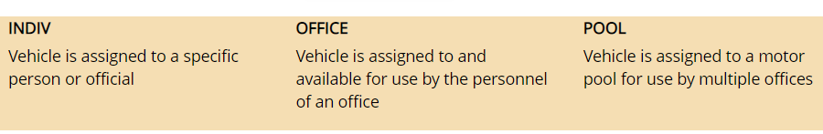
Assignment Type
Assignment type is a FAST requirement.
Click the drop-down box and select one assignment type.
Click Save
Note: Shared: is not a commonly used assignment type. If you believe your vehicle is shared between two different government agencies, please contact your fleet manager or PPMO.

Slide 34
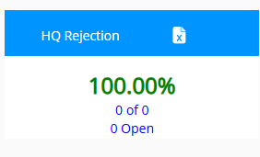
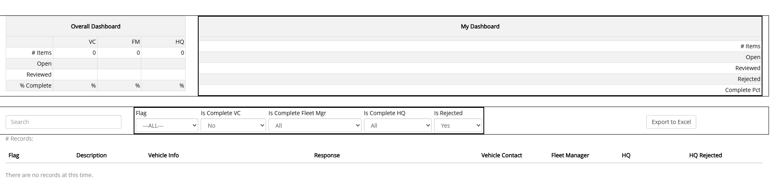
HQ Rejection
The HQ Rejection screen is utilized in times where specific flags may not have been addressed correctly by the user.
For example, if the user certifies a vehicle that has negative miles, this is an error and DOL Leadership will reject it.
The user will need to make the necessary correction before the Rejection will disappear.

Slide 35
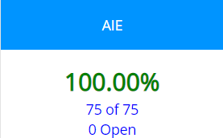
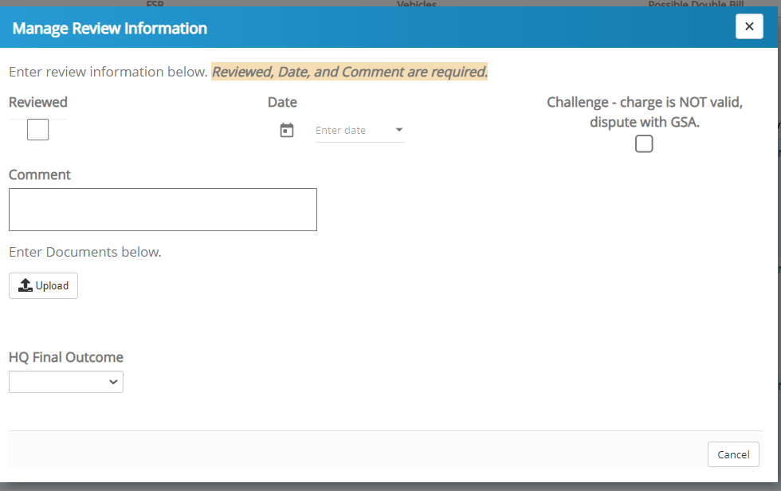
AIE- Agency Incurred Expenses
Each month, the user should review the charges to ensure that GSA is correctly charging the agency.
Be on the lookout for
  Duplicate charges
  Charges for items that should be covered in the lease (Car wash, Oil Change, Recalls etc.)
If the Charge is incorrect, mark as Challenged in AUTOS.
Then, contact your DOL fleet manager or your FSR in order to inquire further.
If the charge is correct, Verify in the system.

Slide 36
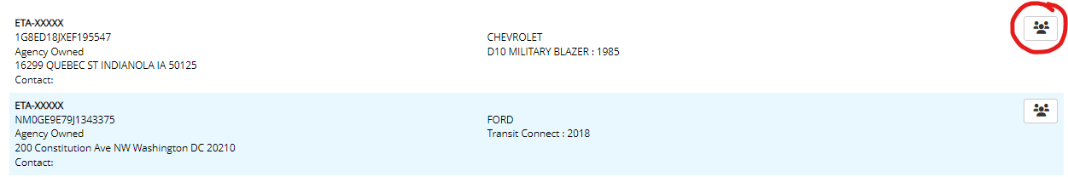
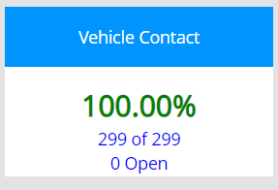
Missing Vehicle Contact
Each vehicle should have a responsible party / contact.
Enter a valid government email address
A vehicle may have more than one contact assigned in AUTOS

Slide 37
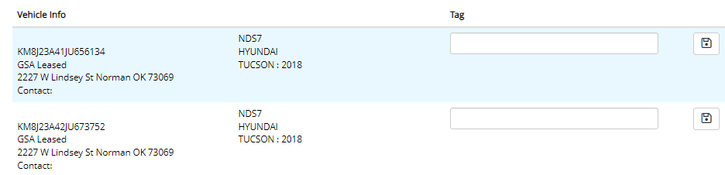
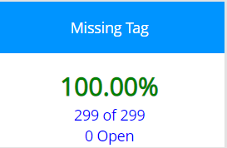
Missing Tag
DOL has made State Tag (If Applicable) required because it's more readily visible than the VIN.
GSA works mostly with Tag Numbers.
Double check your entered tag before hitting save.

Slide 38
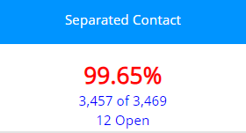
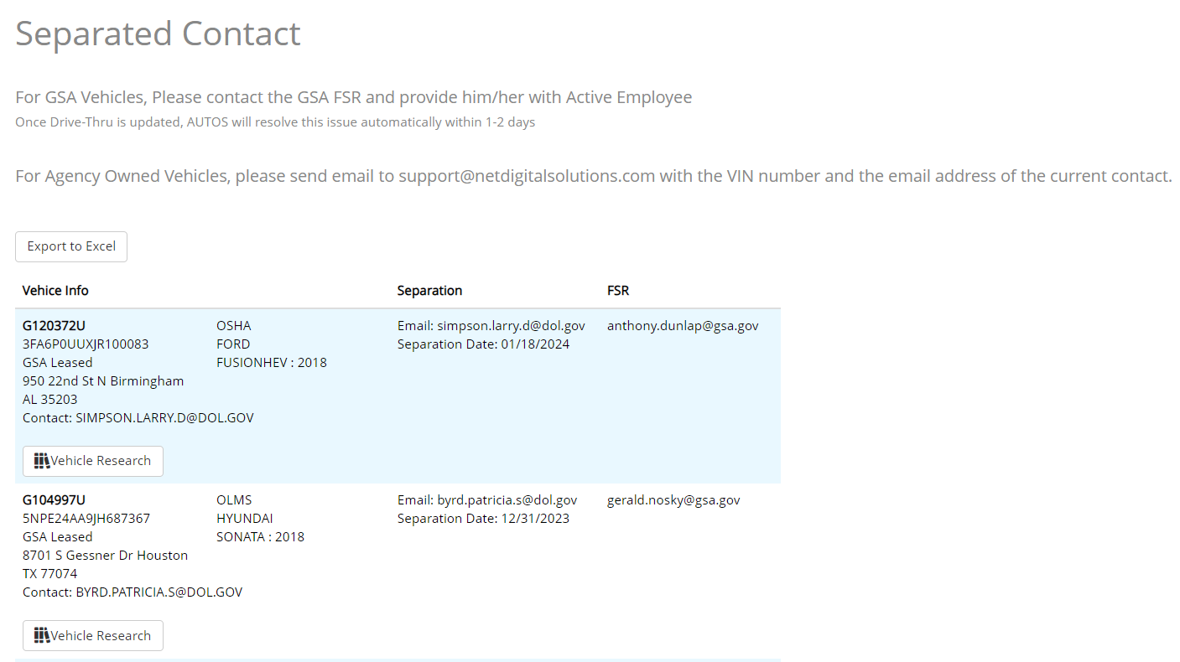
Separated Contact
This page is informational. There is no task to complete on this page.
You are being notified that a vehicle contact was found on the Separations report. The vehicle required a vehicle contact within GSA.
Please proceed to GSAFleet to update the vehicle contact.

Slide 39
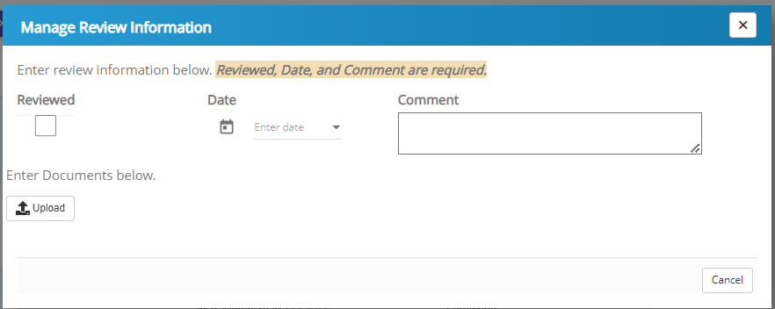
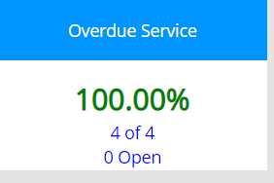
Overdue Inspections/PM Service
The system alerts you when GSA has determined a service has been missed.
Mileage is estimated by GSA. If estimated mileage is wrong, please contact GSA FSR to correct.
The PM is a mandatory annual requirement, even if the mileage requirement has not been met.
Be sure to address any overdue service promptly because overdue services can turn into an AIE.
Please check with your GSA FSR or GSA Drivethru to determine what specific service was missed.
Certifying in AUTOS shows that you are aware of the overdue service, you may certify and enter a proposed date of service, or any documents. (Example: Proposed date on June 7th, 2022, waiting on parts).
This will help keep a historical record.

Slide 40
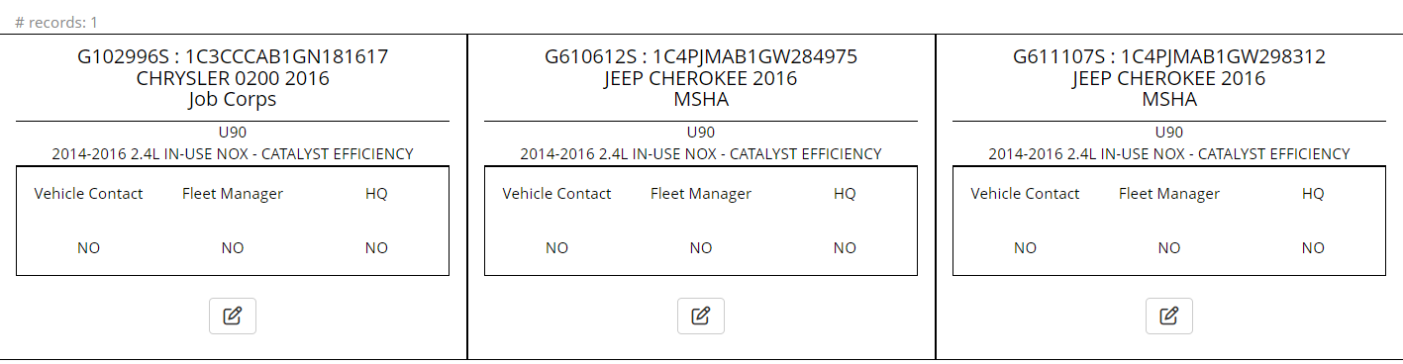
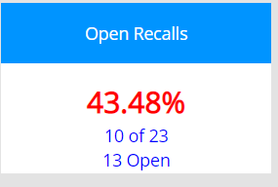
Open Recalls Alert: Change Notice
Open Recalls can turn in AIE if not addressed within a reasonable amount of time.
As with Overdue Service, certify/verify that you are aware of the recall and input any relevant information.
This page can be helpful for storing historical information or comments.
After 2 weeks being in the shop: Inform FSR by email by GTAG and VIN, Address, and contact phone number, short blurb of why the vehicle is there--- ask the FSR to expediate. Then follow up once per week, send a within the same chain to keep records.
If it reaches 30 days, please include Joe in the CC.

Slide 41
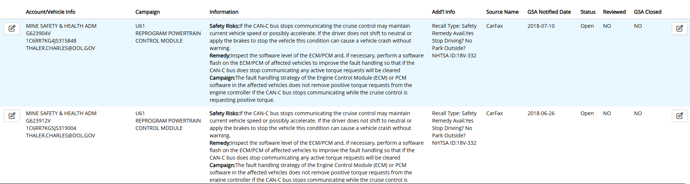
Open Recalls- Alert: Change Notice
RECALLS file has been changed. Be aware of the new format.
It is critical to keep track of and manage these SAFETY Recalls swiftly.
Open Recalls will now be reviewed by the fleet manager and DOL Headquarters to ensure that are being addressed swiftly and all safety hazards are remediated. recalls

Slide 42
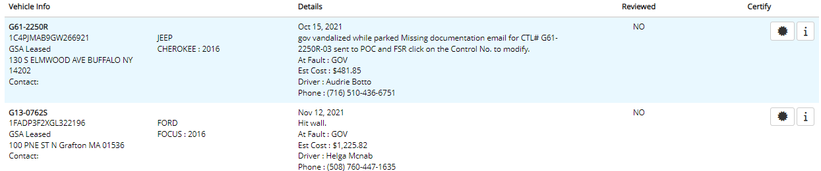
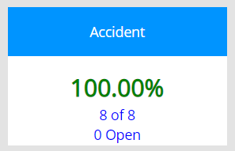
Accidents
GSA tracks accident information
By reviewing this information, you want to ensure that the charge is correct.
Pay special attention to the “At Fault” area.
If incorrect, charges may be refunded/credited
Verify using the STAR icon
Enter as much information or as many documents as possible

Slide 43
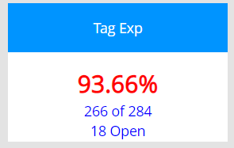
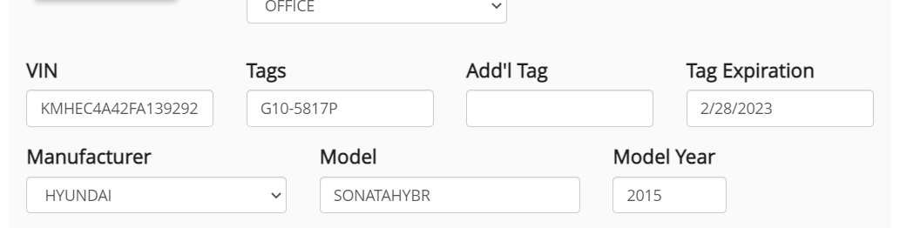
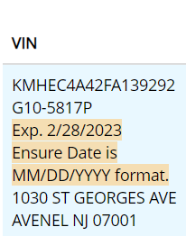
Tag Expiration Date: New Category
State Tag Expiration refers to any Tag Expiration. All GSA/Owned/Commercially leased tags
now have an expiration date that should be entered into AUTOS for tracking.
Over the course of a vehicle’s lifecycle, the G-tag or State Tag will expire.
When we are notified that the tag has expired, it will show up under this category for updating.
Click Edit (Pencil Icon), and enter in new expiration date.
now have an expiration date that should be entered into AUTOS for tracking.

Slide 44
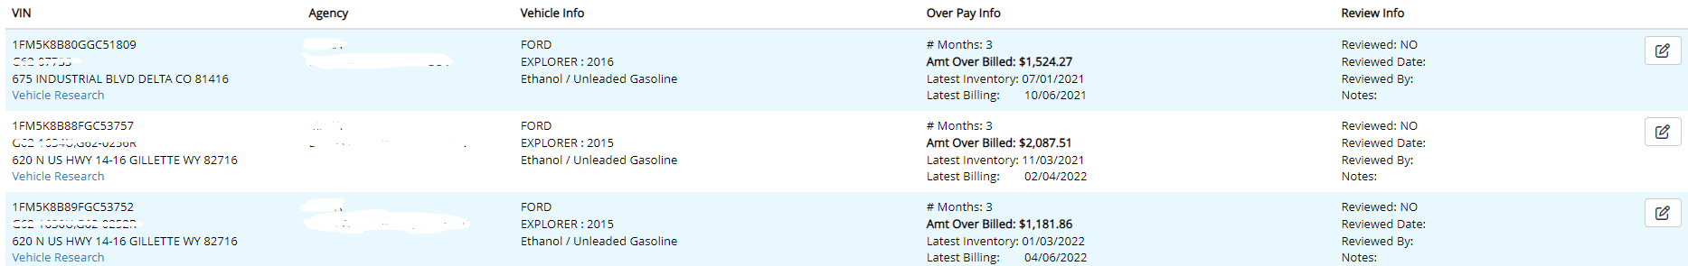
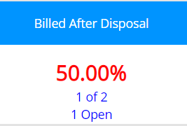
Billed After Disposal
This information is provided by GSA and VCSS.
The charges that are included are 3 or more months after the vehicle was last seen in the inventory.
The purpose (Importance) of the Billed After Disposal Tab is to ensure vehicles that have been disposed are no longer being charged monthly lease rates, fuel, etc.
There are multiple reasons for getting a bill for a vehicle after the disposal date:
    Vehicle hasn’t been disposed and is still active in your fleet
    Vehicle had damages when turned in and GSA is billing the agency to recover repair cost
    Vehicle was turned in early, so agency is still responsible for the monthly lease until the lease ends or the vehicle is reassigned.
    GSA is improperly billing the agency for a vehicle that is no longer part of its fleet
In many cases the billings are valid, but you will need to research to ensure. The local vehicle POC may be able to quickly resolve the question. The next step would be the GSA FSR.
If an error is found, you will need to work with GSA to receive a credit.

Slide 45

Monthly Fleet Reports (MFR)
The Monthly Fleet Report (MFR) is sent to Agency Fleet Managers on or about the 15th of every month.
The MFR is a STATIC Report - A snapshot of the AUTOS system and your vehicle data at a specific moment in time.
AUTOS and the MFR may not match 100% due to updates that may occur after the report is generated. AUTOS is a live site and captures information in real time!
This report extracts and organizes the data in AUTOS to flag any additional data inconsistencies
Utilize the monthly report to correct any issues that are still outstanding. See example below.
What’s wrong in this Fleet Management Report?
  The report shows that the vehicle contact validated a negative mileage.
  This type of mileage is NOT possible.
  Using the fleet report as a reference, Log into AUTOS, Find Vehicle 2GNALBEK9H159880 and Correct this.

Slide 46

VAM Survey
Vehicle Allocation Methodology

Slide 47
VEHICLE ALLOCATION METHODOLOGY (VAM) SURVEY:
VAM is a federally mandated program governed by congress that is implemented using a questionnaire. VAM’s are to be conducted no less than every three to five years upon all federal fleets. Vehicle contacts and fleet managers must complete this survey for each vehicle to ensure their needs and insights are considered by HQ leadership when assessing and determining each vehicles final outcome disposition decision.
Purpose:
This survey is to accurately account for each actively assigned agency owned (AO) and GSA lease (GL) vehicles utilization, primary purpose, right size, class, & type vehicle required (fleet matrix) to include which are emergency service and mission-critical vehicles actively assigned; and to determine the need for possible realignment, downsizing, upsizing, or removal/reduction of vehicles from the fleet.
Note:
if a vehicle has had an Excessive Low Utilization (ELU) survey completed in AUTOs that information will be auto populated within the VAM survey. Vehicle contacts can edit that information as needed or leave as is if no edits are required. The additional VAM questions will still be required to be completed (answered fully). For those vehicles that were approved by Department HQ Fleet Manger for “Turn in’ without a replacement requested in the current FY25 CAM there will be no VAM survey requirement (many of these vehicles have already been turned in to GSA).
Responsibilities:
ATTN: All DOL vehicle contacts and Agencies Fleet Managers must complete this survey for each assigned vehicle, including emergency service vehicles within AUTOs.
Vehicle contacts survey period: April 17 – June 2nd, 2025 Close of Business
Vehicle Contact will input answers to the best of their knowledge and all questions must be answered
Agencies Fleet Managers will review, approve, or reject each questionnaire. If rejected, comments will be provided as to why and what is required, and the vehicle contact will be notified by email to make corrections
Agencies Fleet Managers must have all 100% of VAM surveys completed (accepted with no further rejections) by June 23rd, 2025
The Department HQ Fleet Manager will have four weeks to assess the results, provide recommendation of final disposition to Director of Real and Personal Property who certifies final approval of disposition decision of vehicles that are recommended for downsizing, upsizing, or removal from fleet (turn in to reduce fleet)
Director of Personal Property will have three weeks to certify those specific surveys as noted above
Notes:
These instructions will show on the page when you log on.

Slide 48
Instructions: All questions are required to be completed (answered) fully. Unanswered questions will cause the survey to show as yellow (incomplete).
Questions will require drop-down selections or free-text answers.
Provide clear, detailed responses where requested.
Initial surveys or surveys that remain unaddressed show as yellow
A completed survey will be highlighted in green.
Rejected surveys by Agency Fleet Managers to vehicle contacts will turn “Red” (when corrected and accepted by Agency Fleet Managers surveys will then turn green)
Green surveys are ready for Department HQ Fleet Manager to assess and recommend final decision disposition
ATTN: Once Agencies Fleet Managers have completed their surveys and show green no additional editing will be allowed (surveys will be locked accept to HQ FMO). Department HQ Fleet Manager may return a survey back to the Agencies Fleet Managers. If a survey is returned each will show as red with comment as to why, what is needed to correct, and will no longer be locked. All retuned surveys must be corrected and retuned back to the Department HQ Fleet Manager in a timely manner to ensure Department HQ Fleet Manager can have all surveys ready no later than July 15th 2025 for the Director of Personal Property.

Slide 49
VAM Survey- In AUTOS
Rather than using outdated excel spreadsheets where it is hard to track progress, we will be using AUTOS which will give real time updates.
The VAM will appear in your Magic Bar
You can click the magic bar category to take you to the page below
OR you can click on the Survey tab on the top ribbon
Notes:
These are the two methods that you can use to get to the VAM Survey.

Slide 50

VAM Survey in AUTOS
Each vehicle contact will be responsible for every vehicle in their possession.
Each survey will contain 31 questions that should be answered to the best of your knowledge and as accurately as possible.
Provide detailed justification and responses wherever possible. This helps leadership understand the mission of each particular vehicle and how it is being utilized by your agency.
  For example: This vehicle is used as a student learning resource.
To see your open items, filter on VC. This stands for vehicle contact.
CLICK ON THE BOX FOR THE VEHICLE TO BEGIN SURVEY

Slide 51

VAM Survey in AUTOS
Once you have filled out the questionnaire as a vehicle contact, be sure to select the APPROVE button. This will send it to your fleet manager for review.
Each fleet manager will review the answers provided to ensure accuracy. If there are issues, the fleet manager will reject, and it will get sent back to the vehicle contact.
The workflow will change colors as appropriate.

Slide 52

VAM Survey
Each question will show green once it has been completed.
The question will auto save once you have made a selection.
The whole survey will turn green when your portion is done.

Slide 53
VAM Survey
Each fleet manager will review the answers provided to ensure accuracy.
Once the Fleet Manager review is complete and approved, the questionnaire will be locked for further changes.

Slide 54
Frequently Asked Questions
Q: When should I log in to AUTOS to work?
A: Reports are generated on the 12th of the month for the previous month.
Example: September’s Monthly report will be ready to review on Oct. 12.
September’s validations and corrections should be made prior to the 12th of the month.
Q: What is AUTOS purpose, and why do I have to manage all these systems?
A: AUTOS brings AWARENESS and INFORMATION. AUTOS works in collaboration with GSA Drive thru
and FNC. AUTOS organizes information and allows users to create custom, in-depth reporting that is not
possible in the other systems. Agency owned information should be maintained in AUTOS as well.
Q: Do we use the Export to Excel button every time we make a correction?
A: No, only when you want to create a report in excel or if you need to send this information to your
Agency fleet manager or GSA FSR.

Slide 55
Frequently Asked Questions
Q: How do you know what is covered and what is not covered?
A: Your GSA leasing agreement.
Q: Do we need to lie, or manipulate odometer readings?
A: No. The goal is to get the most accurate data possible. Our system is designed to flag POTENTIALLY concerning data fields or alert the vehicle users to missing information.
Q: How do you change the Temporary password?
A: Click on the Sign Off button in the upper-right hand corner. Click on Reset Password. You will receive an email with a link to reset your password.

Slide 56
Frequently Asked Questions
Q: How do we make sure we do not have an AIE as a result of the delay for the recall being taken care of?
A: Ignoring a recall for an extended time can result in an agency incurred expense. Keep your GSA FSR in the loop by letting them know that the vehicle is in the shop, waiting on parts, etc. This allows GSA to know that you are doing your part to correct the recall.
Q: So, once you make a note and review it, it closes out the recall. How do you know 3 weeks from now that you still have an open recall?
A: The system re-sorts the recall to the “certified” section. But you can always review that by filtering on ALL, if you’d like to review it at a later time. Another thing to consider is that: the recall will REAPPER on the open recall section if during the next GSA download the recall is STILL open.
Q: If you have various sites for vehicle locations (physical off-center location OA site) we are inputting the off-center garage location, correct?
A: For reporting purposes, we need to know the location where the vehicle is parked.

Slide 57
Frequently Asked Questions
Q: Can you tell in AUTOs what the service missed was?
A: No; the file from GSA does not distinguish this for us. You may try logging into GSA DriveThru, or contacting your FSR for that information.
Q: How often are the updates?
A: Our updates happen on an as-needed basis. Any requests will be reviewed by the project manager and will be implemented if necessary.
Q: Do I need to put in a disposal date for a vehicle?
A: Only if the vehicle is Agency Owned

Slide 58
Frequently Asked Questions
Q: What do you do if the GSA card is missing? Who do you contact?
A: If you lost a GSA gas card, contact your local GSA FSR for replacement immediately
Q: Do we still fill out accident form 91?
A: Yes, please continue to fill out all proper forms and logs.
Q: Should we verify something even if it has incorrect information?
A: The AUTO’s System collects and categories information for the user to easily review and point out mistakes. If the information provided from GSA is mistaken, click on the verify/certify button and be sure to include that information in the notes. This way the information can be tracked through the life of the vehicle. It is also a advised to contact your GSA FSR as soon as possible to get the information updated in GSA.

Slide 59
Questions?

