Slide 1


Virtual Training
Fleet Management Information System (FMIS)
Automobile Use Tracking On-Line System (AUTOS)

Slide 2

For Assistance (Contact Us)
For general system/login ID/password issues:
  support@netdigitalsolutions.com
OASAM BOC Fleet Management Program
  zzPPMO-FleetManagement@dol.gov
  cevasco.joseph.a@dol.gov
  butler.brianna.k@dol.gov

Slide 3
Why is maintaining AUTOS and GSAFleet.gov is important?
  AUTOS gathers data from GSA and other sources to alert to any potential data issues.
  Logging in monthly keeps information current and accurate.
  Reduces workload at the end of the year for FAST submission (Federal Automotive Statistical Tool).

Slide 4
When to access AUTOS
AUTOS gathers data from numerous sources.
The fuel file is ready AFTER the 5th of the month, for the prior month.
For example, on June 5th, May data is ready.
Some data is imported weekly.
It is good practice to log into AUTOS weekly to maintain data.

Slide 5
Official Guidance
Net Digital Solutions is the contractor for the Fleet Management System, AUTOS.
Net Digital is here to support you with any concerns related to the system’s operation.
DOL, OASAM, and BOC establish guidelines and policies in alignment with GSA Fleet protocols. Agency Fleet Managers are responsible for overseeing deliverables, tasks, and timelines.
Please ensure that you follow Department- or Agency-specific tasks and deadlines.
Note: Department-level deliverables may differ from agency-level deliverables, as agencies may require additional staff review or approval before final submission.

Slide 6
Why Maintaining AUTOS and GSA are important to DOL Fleet Mission
GSAfleet.gov
AUTOS- DOL Specific
Ensure Mileage is accurate for billing purposes
Logging in monthly to ensure all data has been entered and is accurate to the best of your knowledge.
Ensure FAST
Federal Mandate for each governmental agency to have a Fleet Management Information system
Easily capture data for data calls requested by DOL Leadership or above.
Easily audit the information that GSA provides

Slide 7
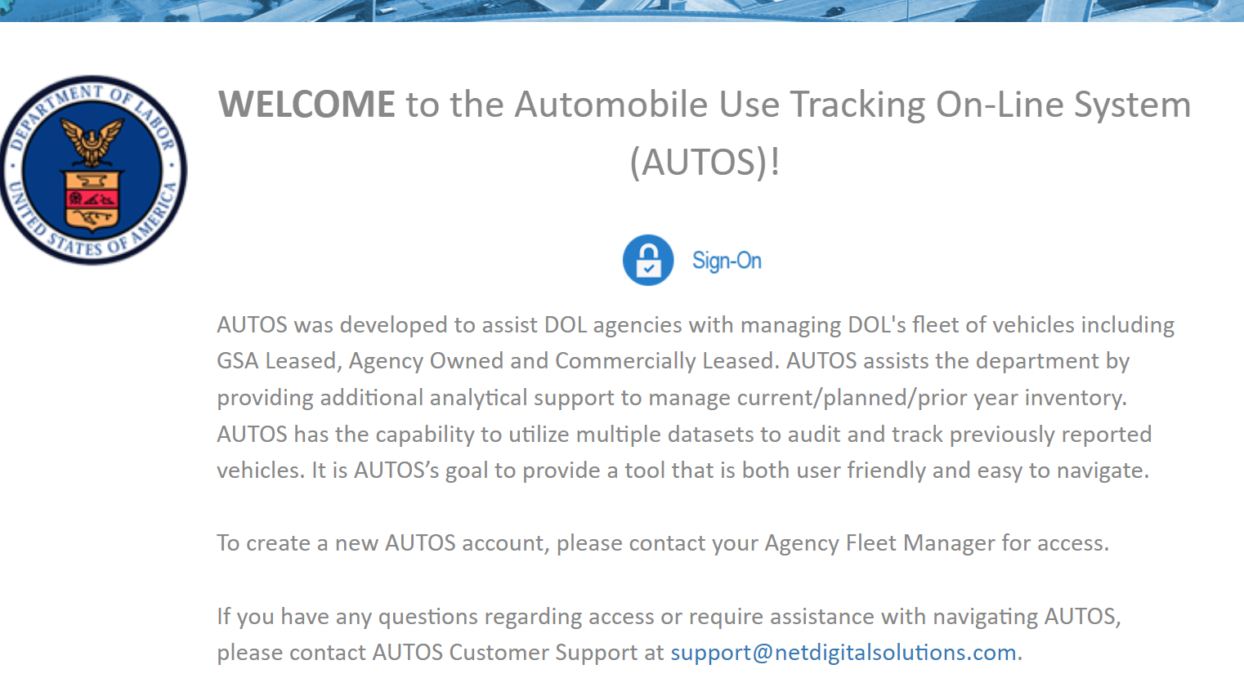
Logging in & Access to AUTOS
URL: https://autosv5.netdigitalsolutions.com
  Click on the Blue and White Sign-On Icon
  Please note that if you are logging in for the first time, you should reach out to your DOL Agency Fleet Manager to create your user account.
  NOTE: DOL may send password reset emails to junk/clutter or quarantine.

Slide 8
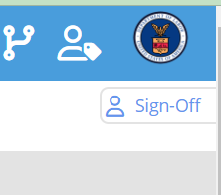
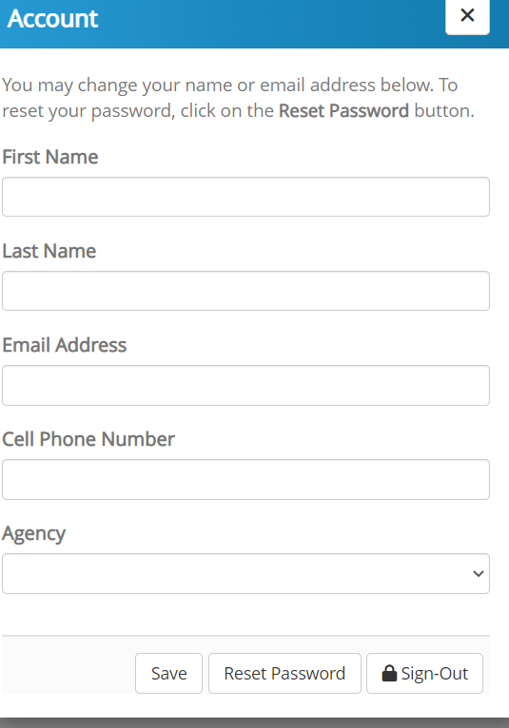
Reset Password
To change the password you were provided, Click on the "Sign-Off" icon in the upper right corner.
A pop up should appear like the one below. Then click "Reset Password". You will receive a link in your email to complete the process.
NOTE: Based on user feedback, a new feature called "My Profile" will house this feature and many more in a future update!

Slide 9

NEW FEATURE- Confirm GSA Contact
Launch Date July 2, 2025
GSAFleet.gov does not allow for changing POC’s.
Only the FSR can perform that function.
By certifying the correct Primary contact in AUTOs, vehicle contacts, fleet managers, and headquarters can run reports to send to GSA FSR’s.
Additionally, AUTOS sends out automatic emails or reports based on the primary POC.
AUTOS is the system of record for Fleet Management so it is critical that AUTOS has the correct information.

Slide 10
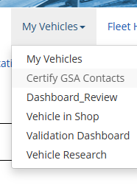
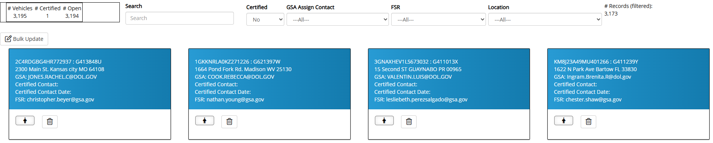
NEW FEATURE- Confirm GSA Contact- Launch Date July 2, 2025
To support the shifts/turnover in personnel across DOL and assist with updating GSA data, this new feature allows you to quickly confirm and change the POC for any GSA Leased vehicle.
              To access, hover over “My Vehicles”
              Click on the Header “Certify GSA Contacts”
              Each blue box depicts a separate vehicle in GSA that should be Certified.

Slide 11
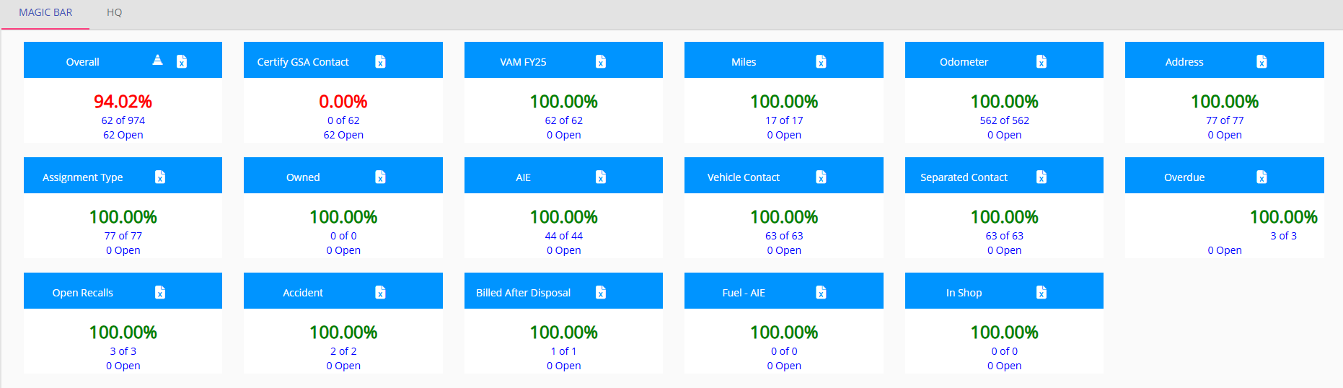
NEW FEATURE- Confirm GSA Contact- Launch Date July 2, 2025
To support the shifts/turnover in personnel across DOL and assist with updating GSA data, this new feature allows you to quickly confirm and change the POC for any GSA Leased vehicle.
              OR go to the “Magic Bar”

Slide 12
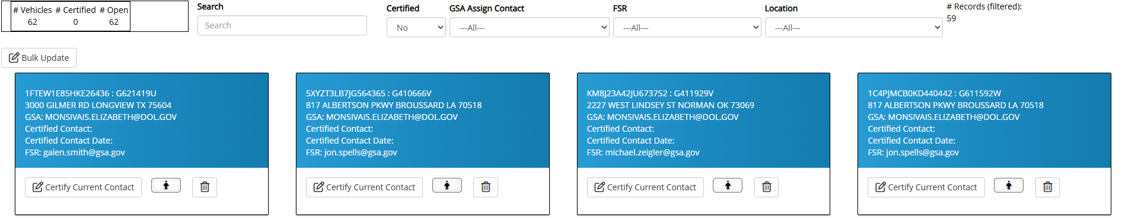
NEW FEATURE- Confirm GSA Contact
              Each vehicle will need to be certified
              To certify that the CURRENT contact listed at GSA is correct, click on “Certify Current Contact” button

Slide 13
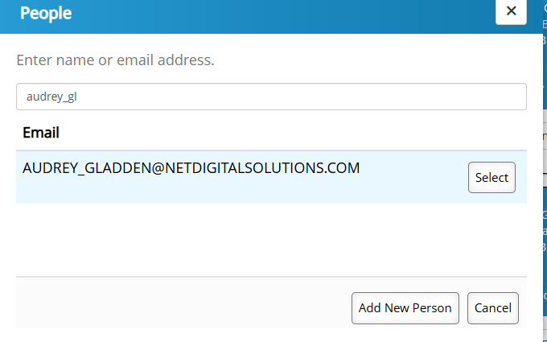

NEW FEATURE- Confirm GSA Contact
              To change the GSA contact, click on the “PERSON” Icon
              Enter a new email address by either copy and pasting or typing an email address.

Slide 14
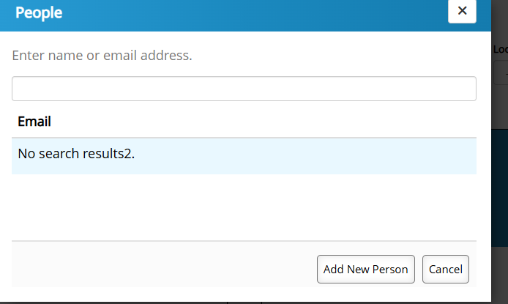
NEW FEATURE- Confirm GSA Contact
              If the contact does not yet exist in the system, you can “ADD A NEW PERSON”

Slide 15
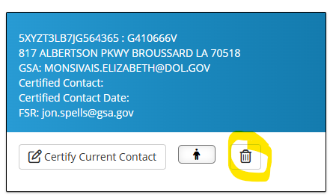
NEW FEATURE- Delete Certification
              If you made a mistake with the certification, you can undo it by clicking the “TRASH” Icon.
              This will remove it from the “Certified” page and move it back to the page with the uncertified contacts.

Slide 16
NEW FEATURE- Confirm GSA Contact
You can update many vehicles at a time by clicking on the button “Bulk Update”
Filter on the current GSA assigned contact or the location to get the desired results.
The vehicles that are showing will be changed in the bulk update.

Slide 17
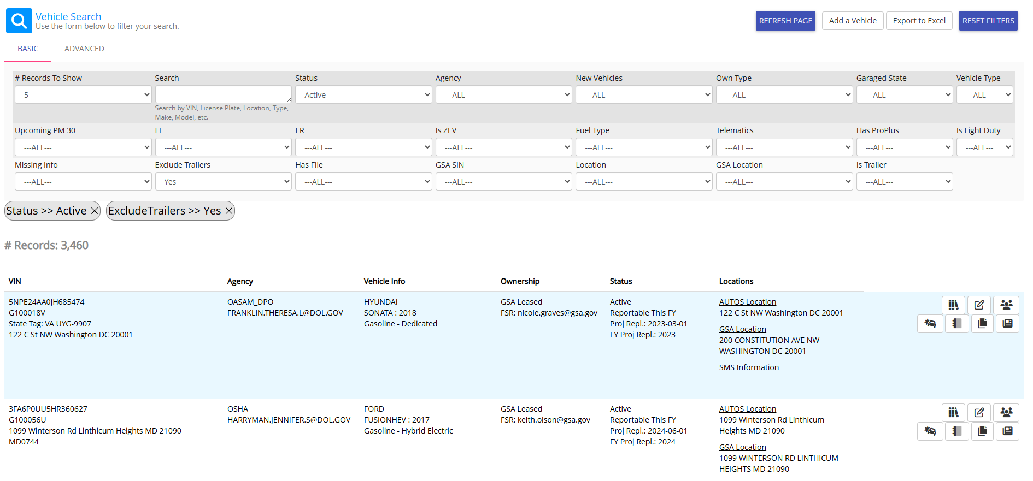
My Vehicles
"My Vehicles" is a designated location to view, edit, and manage your vehicles at a glance.
DOL’s fleet managers can view all the vehicles in their agency.
Vehicle Contacts will only see their local vehicles.
Click on the person icon to the right to add Additional POCs to help distribute the workload.

Slide 18

My Vehicles- Common Question
What if I don’t see a vehicle I know is mine?
GSA leased vehicles will have the GSA listed contact as the primary POC automatically.
Reach out to your Fleet Manager or the primary contact to assign you to the vehicle as well.
For Agency Owned vehicles, please contact your DOL Fleet Manager.

Slide 19

Manage My Vehicles- Telematics
"My Vehicles" allows users to view all pertinent vehicle info with a click.
Circled here is "Telematics Info".
If the vehicle has telematics installed, reported mileage will be displayed here.
NOTE: If Telematics is incorrect, please reach out to your FSR to get it correctly.
  However, there may be a delay or a mismatch in the date the data is collected.

Slide 20
Manage My Vehicles- Vehicle Research
"My Vehicles" allows users to view all pertinent vehicle info with a click.
Circled here is "Vehicle Research".
This is a deep dive on the historical vehicle information.
Excellent tool for when you have a question about a GSA Disposed vehicle.

Slide 21
Manage My Vehicles- Odometer
"My Vehicles" allows users to view all pertinent vehicle info with a click.
Circled here is "Odometer"
  This feature is undergoing construction.
  Upon completion it will take you directly to the odometer record for that particular vehicle.

Slide 22
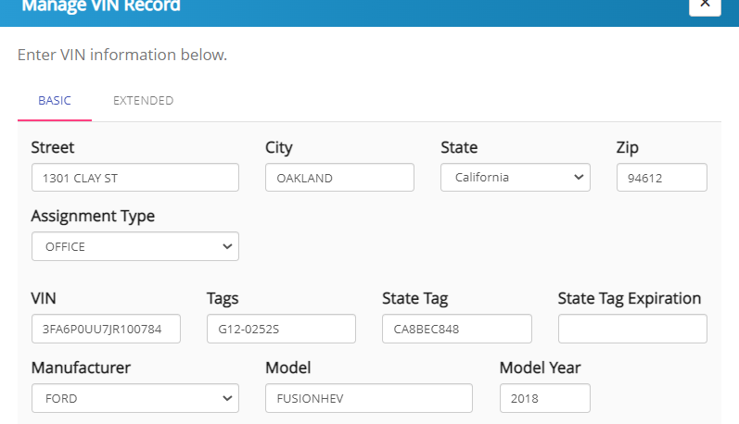
Manage My Vehicles- Edit
Circled here is "Edit".
Over the life of the vehicle, the user may need to update the address, or tag information.
  Note: JCC does not have any LE, ER, or ARM vehicles.

Slide 23
Manage My Vehicles- Change Address
Circled here is "Edit".
In order to change the address, carefully type the garaged location of the vehicle.
Garaged address is the physical location of the vehicle. Should be the parking structure.
No personally Identifiable Information should be stored in AUTOS
Take care to hit “SAVE” at the bottom of the screen before exiting.

Slide 24
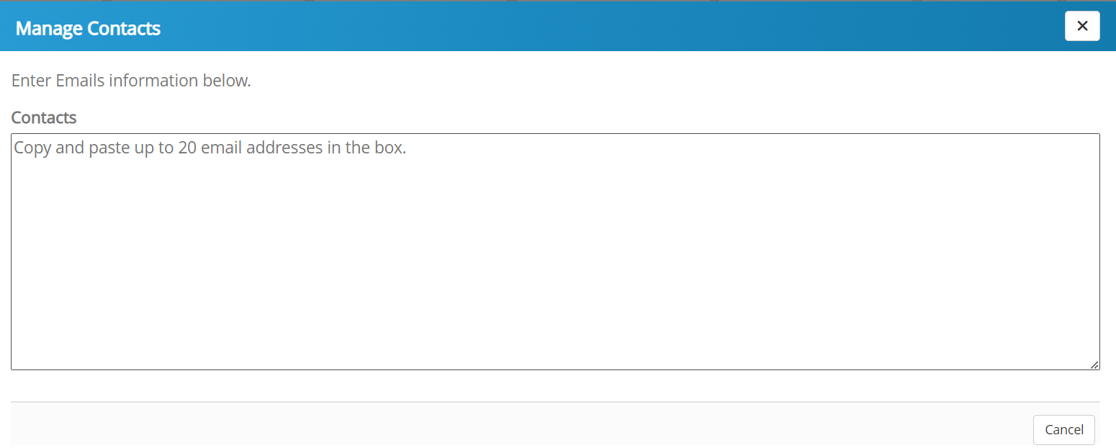
Manage My Vehicles- Vehicle Contacts
Circled here is "Manage Vehicle Contacts".
Add any contacts who you wish to help you with your responsibilities
NOTE: GSA does not allow editing of the primary contact in fleet.gov at this time. You must reach out to your FSR to get that updated.
AUTOS does not reflect/update BACK to GSA.

Slide 25
Manage My Vehicles- Accidents
"My Vehicles" allows users to view all pertinent vehicle info with a click.
Circled here is "Accident".
Review any pertinent information from the GSA Bill.

Slide 26
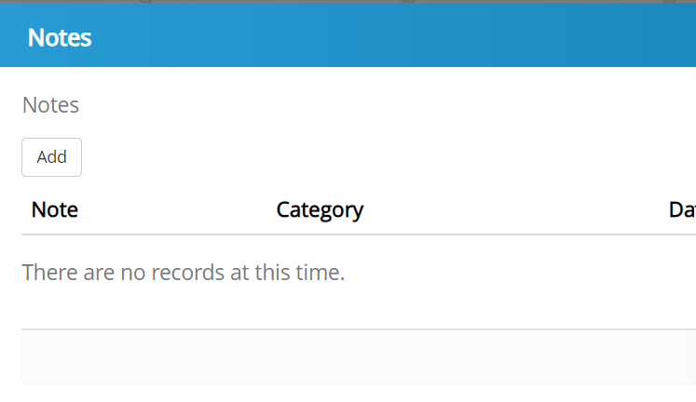
Manage My Vehicles-- Notes
Circled here is "Notes".
Add any notes you wish to communicate for future reference or for your team to see.

Slide 27
Manage My Vehicles-- Files
Circled here is "Files"
Upload any necessary files that you want to be attached to this vehicle record.
All GSA vehicles are required to upload 1152 documents.
Utilize the file button to create a historical record for each vehicle.

Slide 28
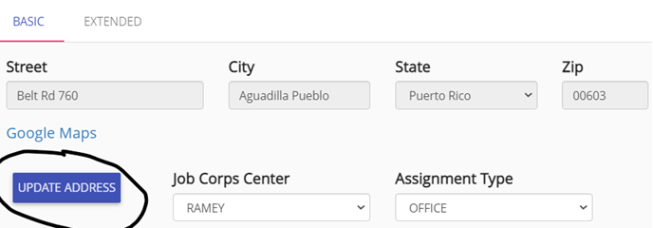
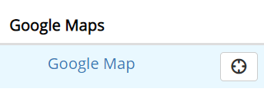
Request Address/Change Address
The purpose of this feature is to ensure that addresses are standardized and synchronized with DOL.
You will see the current address and a button underneath "Update Address".
"Update Address" will bring up a page for searching for a list of approved DOL addresses.
Be sure to put in the garaged address. The physical location of the vehicle. Garaged Addresses CANNOT be suite numbers or P.O. Boxes.
If the address is not in the system already, you will need to "REQUEST ADDRESS ADDITION".

Slide 29
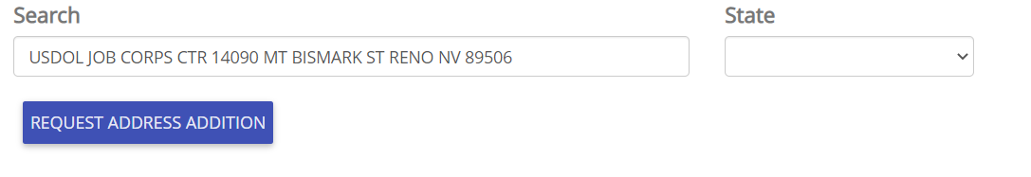
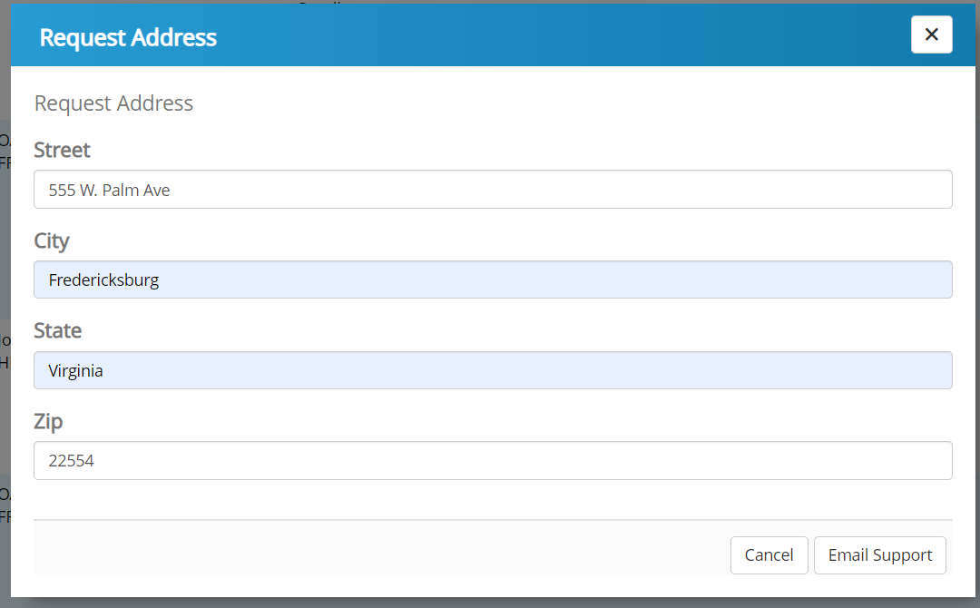
Request Address/Change Address
Complete the form with the Garaged Address.
Click "Email Support" to complete the process
The new location will be reviewed by HQ

Slide 30
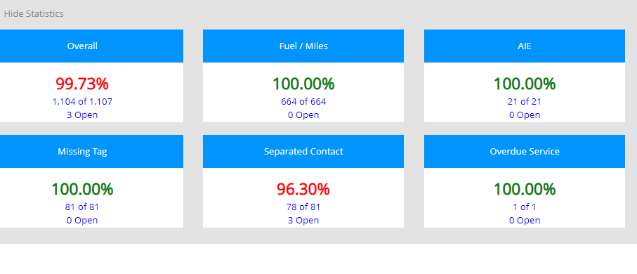
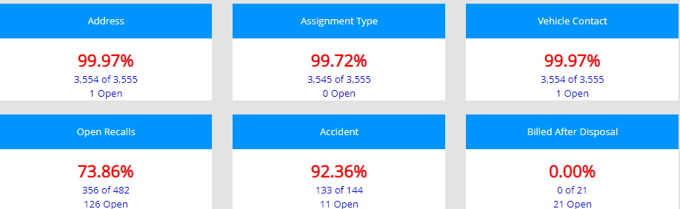
Magic Bar/Flagged Data Elements- Dashboard
Dashboard elements may change and/or expand based on governmental requirements and reporting mandates.
The Dashboard is an overview of critical data categories.
Ensures that no critical data fields are missing.
The data comes in monthly from GSA but is 1 month behind.
Agency Fleet Managers will see their entire agency fleet's progress.
As a vehicle contact, you will see only your progress for your assigned vehicles.
The goal is to get each category to 100% green!

Slide 31
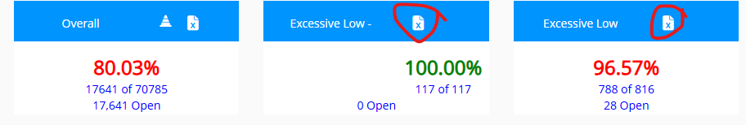
Magic Bar/Flagged Data Elements- Dashboard
The grey bar expands or hides your MAGIC Bar/Dashboard.
Be sure to expand the magic bar to review the data the needs to be completed.
Click on that element to get a look at the specific fields required.
You may also export to excel by clicking the “paper icon” in the top right of the category.

Slide 32
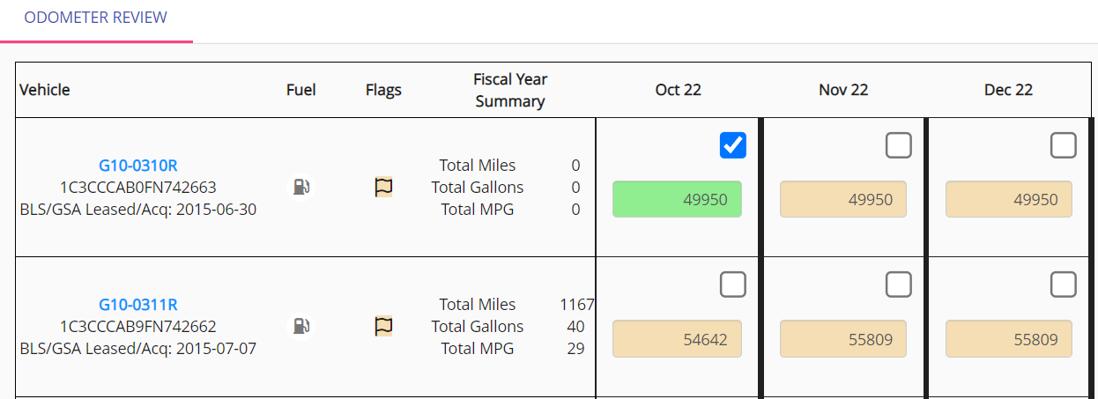
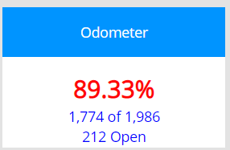
Odometer
NDS receives this data from GSA monthly. The data shown will be for the prior month.
When you click certify/verify, you are confirming that the information that came over from GSA is correct.
Click the check box when done!
The system will flag negative odometer miles or excessive miles.
Review to ensure the ENDING Odometer Reading is correct.
  Quick Tips:
    ANY vehicle that was in the inventory in the current fiscal year will be required for review.
    Vehicles that are disposed with show a grey box and a disposal date.

Slide 33

Miles Review
A vehicle will have a yellow flag appear when there may be an issue with data consistency.
A flag helps users see a potential problem.
Some examples include:
  3 consecutive months with no fuel, gallons, or miles
  High Miles Per Gallon (MPG)
  High mileage
  Or any other anomalies that need further review.
If the information is correct, simply click the check button.
If the information is inaccurate, please update

Slide 34
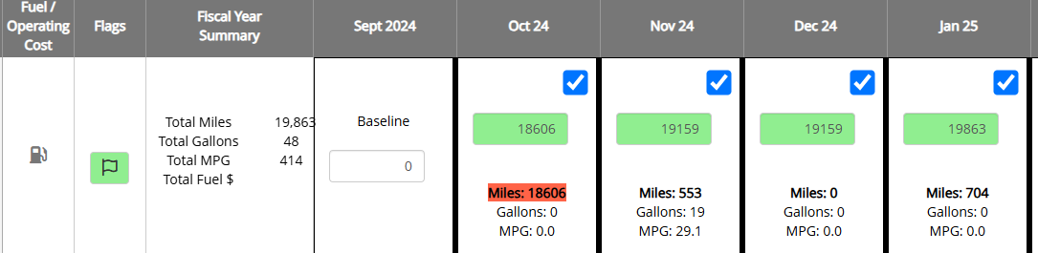
Miles Review- FAST Concerns
For Example: Here the Red Highlighted Mileage indicates that there is an issue.
The Baseline reads zero, but the vehicle odometer reads 18,606 in October. The vehicle could not have driven 18k miles in one month, so please fill out the odometer reading for the month of September to resolve the error.
Make sure to correct in GSA Fleet.gov as well.

Slide 35
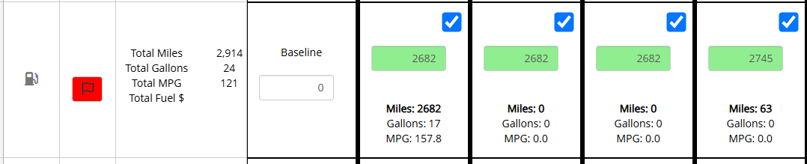
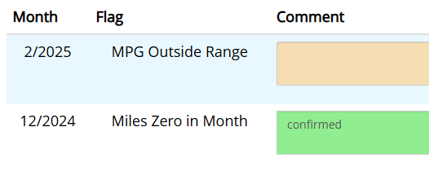
Miles Review- FAST Concerns
For Example: The flag is highlighted RED. Please click on the flag to bring up the concerns and resolve.
You see that the MPG is flagged. The vehicle was driven 2,682 miles but only purchased 17 gallons of fuel.
This is misaligned with the Vehicle’s Miles Per Gallon per the manufacturer.
When this occurs, the user will need to either add fuel or correct mileage.
To resolve, we need to adjust the baseline reading to the include odometer reading for Sept 2024.

Slide 36
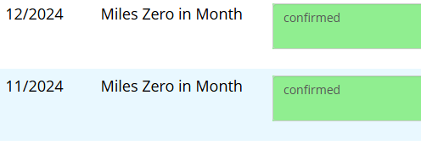
Miles Review- HQ Concerns
You may also get a flag if your vehicle has driven 0 miles in a given month.
Please provide an accurate reason for why this vehicle was not utilized.
Excessively Low utilization may require the vehicle to be turned in. ***
Confirmed is not a valid response.
Example:
Vehicle in Shop- Waiting on part
Vehicle in Accident
Vehicle driven but not fueled
Vehicle not needed for mission

Slide 37

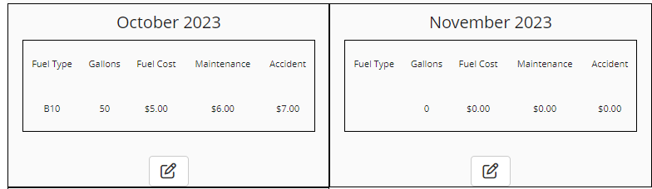
Operational Cost for Agency Owned
For FY25, our mission is to gather as much accurate information on agency owned operational costs prior to our FAST Submission.

Slide 38
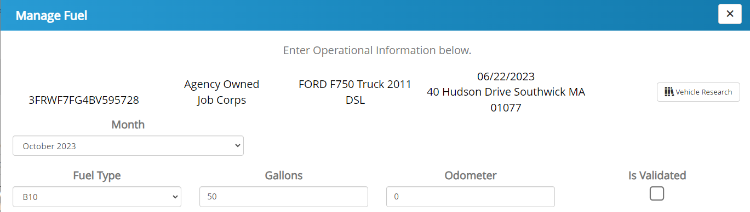
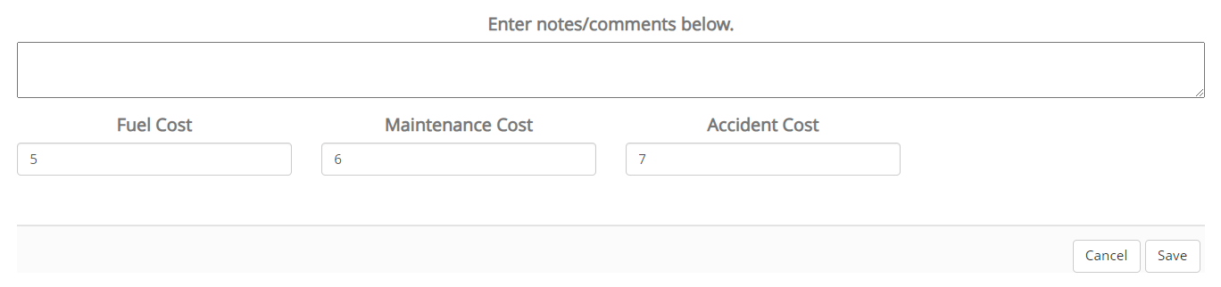
Operational Cost for Agency Owned
If there is no operational costs for that particular month, be sure to enter a comment explaining why.

Slide 39
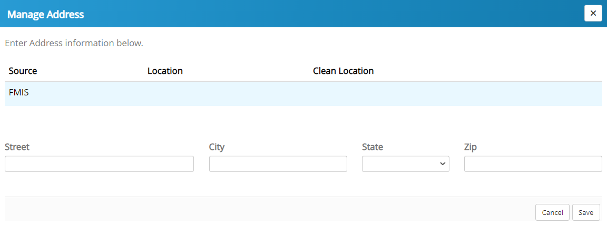
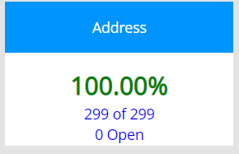
Missing Address
The garaged address is required for FAST submission
A suggested address will populate, if one exists.
Either confirm the suggested address or
Type in a new address with extra attention to detail

Slide 40
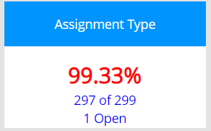
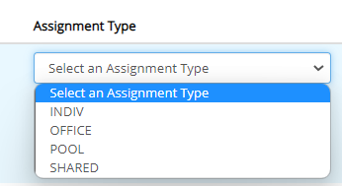
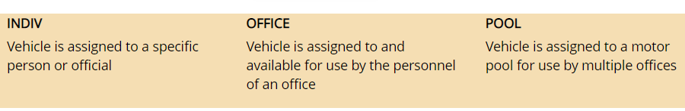
Assignment Type
Assignment type is a FAST requirement.
Click the drop-down box and select one assignment type.
Click Save
Note: Shared: is not a commonly used assignment type. If you believe your vehicle is shared between two different government agencies, please contact your fleet manager or PPMO.

Slide 41
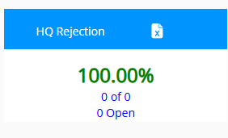
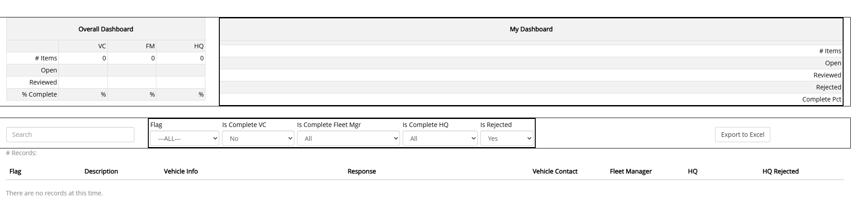
HQ Rejection
The HQ Rejection screen is utilized in times where specific flags may not have been addressed correctly by the user.
For example, if the user certifies a vehicle that has negative miles, this is an error and DOL Leadership will reject it.
The user will need to make the necessary correction before the Rejection will disappear.

Slide 42
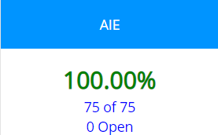
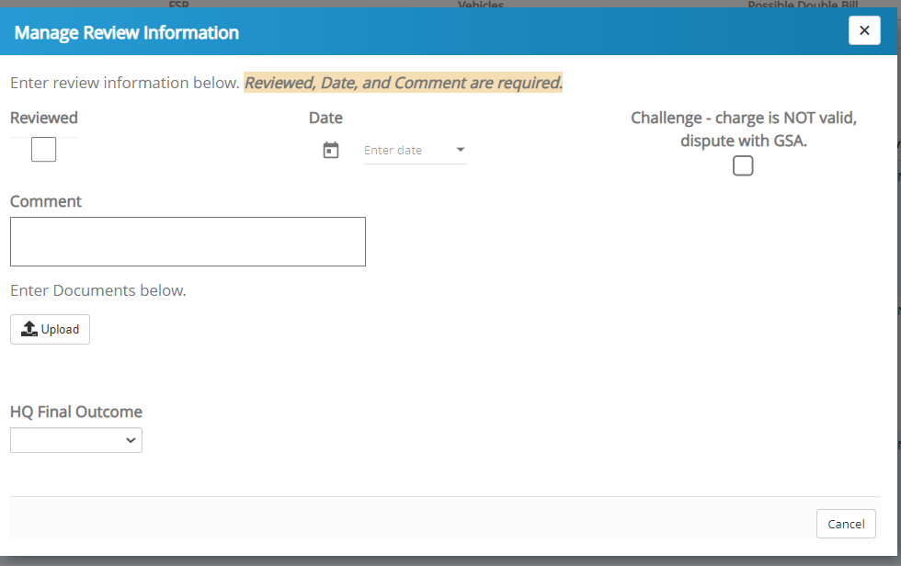
AIE- Agency Incurred Expenses
Each month, the user should review the charges to ensure that GSA is correctly charging the agency.
Be on the lookout for
  Duplicate charges
  Charges for items that should be covered in the lease (Car wash, Oil Change, Recalls etc.)
If the Charge is incorrect, mark as Challenged in AUTOS.
Then, contact your DOL fleet manager or your FSR in order to inquire further.
If the charge is correct, Verify in the system.
NOTE: Check your wet lease or with your FSR if you are not sure about covered items.

Slide 43
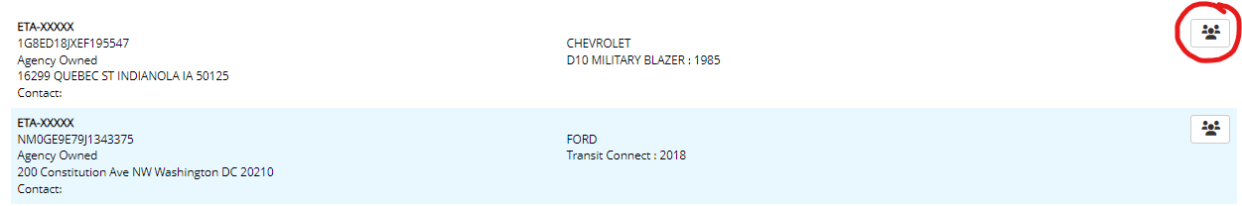
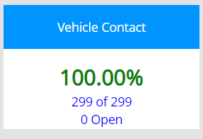
Missing Vehicle Contact
Each vehicle should have a responsible party / contact.
Enter a valid government email address
A vehicle may have more than one contact assigned in AUTOS

Slide 44
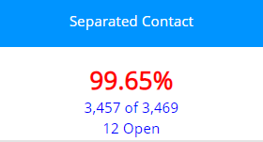
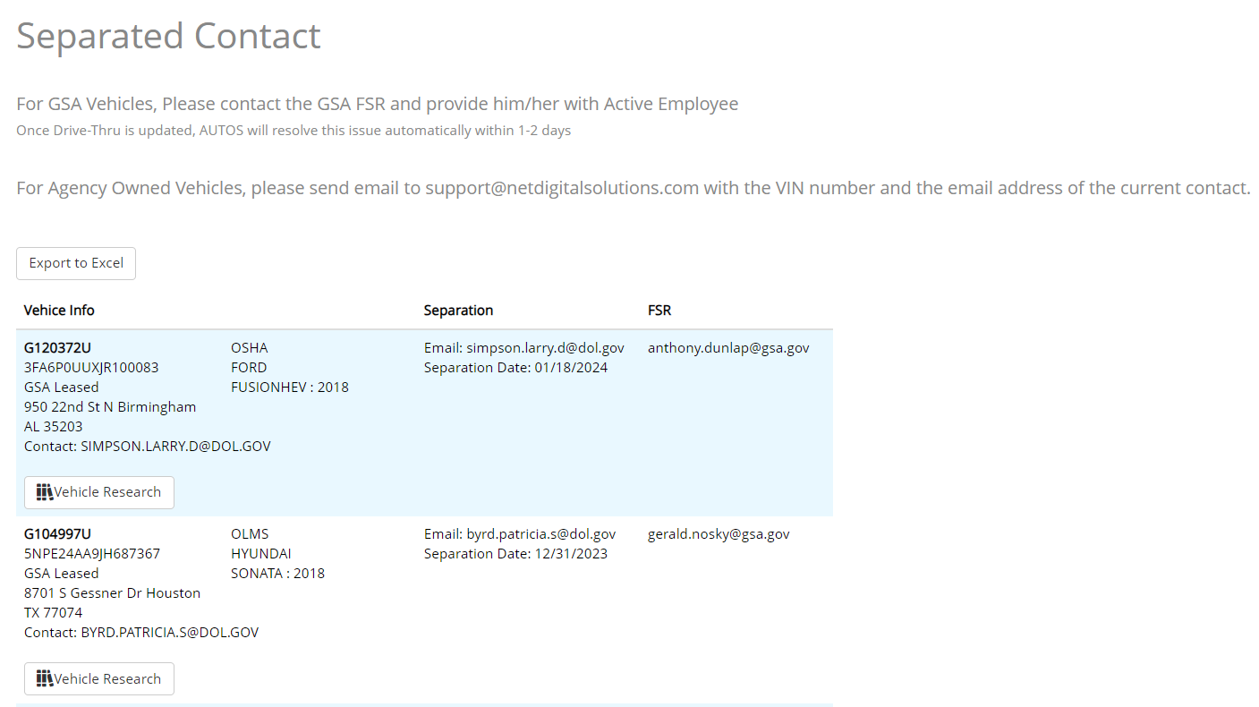
Separated Contact
This page is informational. There is no task to complete on this page.
You are being notified that a vehicle contact was found on the Separations report. The vehicle required a vehicle contact within GSA.
Please contact your GSA FSR for that vehicle to update the vehicle.
Follow instructions for the new “Certify GSA Contact”

Slide 45
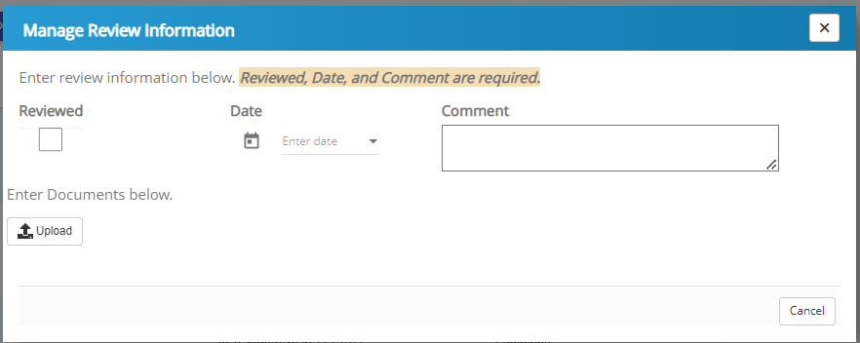
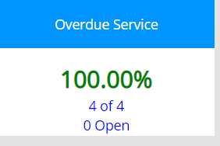
Overdue Inspections/PM Service
The system alerts you when GSA has determined that a service has been missed.
Mileage is estimated by GSA. If the estimated mileage is incorrect, please contact your GSA FSR for correction.
The PM (Preventive Maintenance) is a mandatory annual requirement, even if the mileage threshold has not been met.
Be sure to address any overdue service promptly, as overdue services can escalate into an AIE (Accident/Incident/Expense).
Please check with your GSA FSR or GSAFleet.gov to determine which specific service was missed.
Certifying in AUTOS indicates that you are aware of the overdue service. You may certify and enter a proposed service date or upload any relevant documents (e.g., “Proposed date: June 7, 2022; waiting on parts”).
This helps maintain a clear historical record.

Slide 46
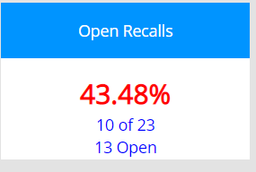
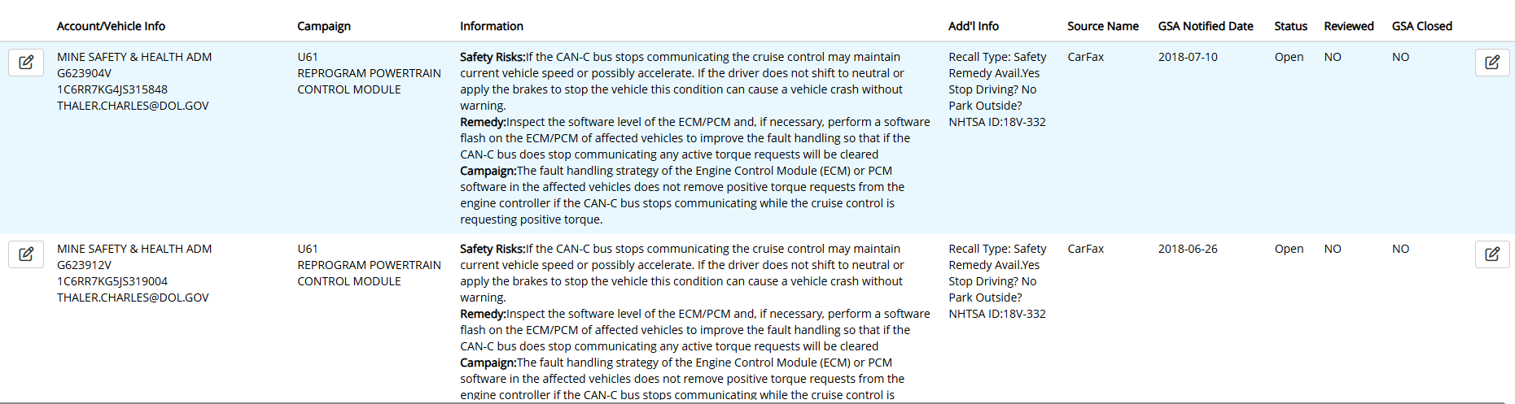
Open Recalls- Alert: Change Notice
RECALLS file has been changed. Be aware of the new format.
It is critical to keep track of and manage these SAFETY Recalls swiftly.
Open Recalls will now be reviewed by the fleet manager and DOL Headquarters to ensure that are being addressed swiftly and all safety hazards are remediated. recalls

Slide 47
Open Recalls Alert: Change Notice
Open Recalls can turn in AIE if not addressed within a reasonable amount of time.
As with Overdue Service, certify/verify that you are aware of the recall and input any relevant information.
This page can be helpful for storing historical information or comments.
After 2 weeks being in the shop: Inform FSR by email by GTAG and VIN, Address, and contact phone number, short blurb of why the vehicle is there--- ask the FSR to expediate. Then follow up once per week, send a within the same chain to keep records.
If it reaches 30 days, please include cevasco.joseph.a@dol.gov, Departmental Fleet Manager, in the CC.
NOTE: If dealer determines that there is no active recall for the vehicle, you must have a print off from the dealership stating there is no such recall. Load the copy into AUTO's and send to FSR. It will not clear immediately.

Slide 48
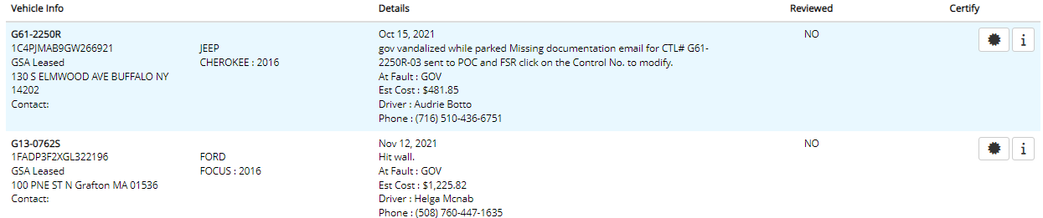
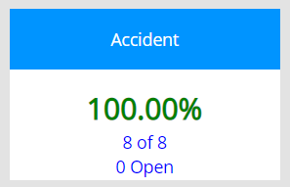
Accidents
GSA tracks accident information
By reviewing this information, you want to ensure that the charge is correct.
Pay special attention to the “At Fault” area.
If incorrect, charges may be refunded/credited
Verify using the STAR icon
Enter as much information or as many documents as possible

Slide 49
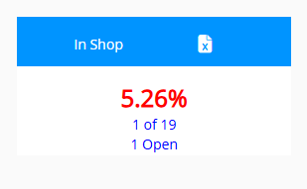

In Shop
This is a self run alert system that allows vehicle contacts to track vehicles that are in shop.
Select the vehicle that has been in the shop and close the vehicle once the work has been completed and the vehicle is returned.
This will allow vehicle contacts, fleet managers, and headquarters to see which vehicles are entering the service stations more frequently and the amount of downtime, which can be used to support gaining new vehicles with GSA.

Slide 50

In Shop
Once you’ve selected your vehicle, you will enter in the information requested.
This is a great tool for continuity of operations.
  If someone is out of office, on leave, or has left the department, this can be a tool to keep track of vehicles that are in shop and easily maintain the documents that go with it.

Slide 51

In Shop

Slide 52



Tag Expiration Date: New Category
State Tag Expiration refers to any Tag Expiration. All GSA/Owned/Commercially leased tags
now have an expiration date that should be entered into AUTOS for tracking.
Over the course of a vehicle’s lifecycle, the G-tag or State Tag will expire.
When we are notified that the tag has expired, it will show up under this category for updating.
Click Edit (Pencil Icon), and enter in new expiration date.
now have an expiration date that should be entered into AUTOS for tracking.

Slide 53


Billed After Disposal
This information is provided by GSA and VCSS.
The charges that are included are 3 or more months after the vehicle was last seen in the inventory.
The purpose (Importance) of the Billed After Disposal Tab is to ensure vehicles that have been disposed are no longer being charged monthly lease rates, fuel, etc.
There are multiple reasons for getting a bill for a vehicle after the disposal date:
    Vehicle hasn’t been disposed and is still active in your fleet
    Vehicle had damages when turned in and GSA is billing the agency to recover repair cost
    Vehicle was turned in early, so agency is still responsible for the monthly lease until the lease ends or the vehicle is reassigned.
    GSA is improperly billing the agency for a vehicle that is no longer part of its fleet
In many cases the billings are valid, but you will need to research to ensure. The local vehicle POC may be able to quickly resolve the question. The next step would be the GSA FSR.
If an error is found, you will need to work with GSA to receive a credit.

Slide 54

Monthly Fleet Reports (MFR)
The Monthly Fleet Report (MFR) is sent to Agency Fleet Managers on or about the 15th of every month.
The MFR is a STATIC Report - A snapshot of the AUTOS system and your vehicle data at a specific moment in time.
AUTOS and the MFR may not match 100% due to updates that may occur after the report is generated. AUTOS is a live site and captures information in real time!
This report extracts and organizes the data in AUTOS to flag any additional data inconsistencies
Utilize the monthly report to correct any issues that are still outstanding. See example below.
What’s wrong in this Fleet Management Report?
  The report shows that the vehicle contact validated a negative mileage.
  This type of mileage is NOT possible.
  Using the fleet report as a reference, Log into AUTOS, Find Vehicle 2GNALBEK9H159880 and Correct this.

Slide 55

VAM Survey
Vehicle Allocation Methodology

Slide 56
VEHICLE ALLOCATION METHODOLOGY (VAM) SURVEY:
VAM is a federally mandated program governed by congress that is implemented using a questionnaire. VAM’s are to be conducted no less than every three to five years upon all federal fleets. Vehicle contacts and fleet managers must complete this survey for each vehicle to ensure their needs and insights are considered by HQ leadership when assessing and determining each vehicles final outcome disposition decision.
Purpose:
This survey is to accurately account for each actively assigned agency owned (AO) and GSA lease (GL) vehicles utilization, primary purpose, right size, class, & type vehicle required (fleet matrix) to include which are emergency service and mission-critical vehicles actively assigned; and to determine the need for possible realignment, downsizing, upsizing, or removal/reduction of vehicles from the fleet.
Note:
if a vehicle has had an Excessive Low Utilization (ELU) survey completed in AUTOs that information will be auto populated within the VAM survey. Vehicle contacts can edit that information as needed or leave as is if no edits are required. The additional VAM questions will still be required to be completed (answered fully). For those vehicles that were approved by Department HQ Fleet Manger for “Turn in’ without a replacement requested in the current FY25 CAM there will be no VAM survey requirement (many of these vehicles have already been turned in to GSA).
Responsibilities:
ATTN: All DOL vehicle contacts and Agencies Fleet Managers must complete this survey for each assigned vehicle, including emergency service vehicles within AUTOs.
Vehicle contacts survey period: April 17 – June 2nd, 2025 Close of Business
Vehicle Contact will input answers to the best of their knowledge and all questions must be answered
Agencies Fleet Managers will review, approve, or reject each questionnaire. If rejected, comments will be provided as to why and what is required, and the vehicle contact will be notified by email to make corrections
Agencies Fleet Managers must have all 100% of VAM surveys completed (accepted with no further rejections) by June 23rd, 2025
The Department HQ Fleet Manager will have four weeks to assess the results, provide recommendation of final disposition to Director of Real and Personal Property who certifies final approval of disposition decision of vehicles that are recommended for downsizing, upsizing, or removal from fleet (turn in to reduce fleet)
Director of Personal Property will have three weeks to certify those specific surveys as noted above
Notes:
These instructions will show on the page when you log on.

Slide 57
Instructions: All questions are required to be completed (answered) fully. Unanswered questions will cause the survey to show as yellow (incomplete).
Questions will require drop-down selections or free-text answers.
Provide clear, detailed responses where requested.
Initial surveys or surveys that remain unaddressed show as yellow
A completed survey will be highlighted in green.
Rejected surveys by Agency Fleet Managers to vehicle contacts will turn “Red” (when corrected and accepted by Agency Fleet Managers surveys will then turn green)
Green surveys are ready for Department HQ Fleet Manager to assess and recommend final decision disposition
ATTN: Once Agencies Fleet Managers have completed their surveys and show green no additional editing will be allowed (surveys will be locked accept to HQ FMO). Department HQ Fleet Manager may return a survey back to the Agencies Fleet Managers. If a survey is returned each will show as red with comment as to why, what is needed to correct, and will no longer be locked. All retuned surveys must be corrected and retuned back to the Department HQ Fleet Manager in a timely manner to ensure Department HQ Fleet Manager can have all surveys ready no later than July 15th 2025 for the Director of Personal Property.

Slide 58
VAM Survey- In AUTOS
Rather than using outdated excel spreadsheets where it is hard to track progress, we will be using AUTOS which will give real time updates.
The VAM will appear in your Magic Bar
You can click the magic bar category to take you to the page below
OR you can click on the Survey tab on the top ribbon
Notes:
These are the two methods that you can use to get to the VAM Survey.

Slide 59

VAM Survey in AUTOS
Each vehicle contact will be responsible for every vehicle in their possession.
Each survey will contain 15 questions that should be answered to the best of your knowledge and as accurately as possible.
Provide detailed justification and responses wherever possible. This helps leadership understand the mission of each particular vehicle and how it is being utilized by your agency.
  For example: This vehicle is used as a student learning resource.
To see your open items, filter on VC. This stands for vehicle contact.
CLICK ON THE BOX FOR THE VEHICLE TO BEGIN SURVEY

Slide 60

VAM Survey in AUTOS
Once you have filled out the questionnaire as a vehicle contact, be sure to select the APPROVE button. This will send it to your fleet manager for review.
Each fleet manager will review the answers provided to ensure accuracy. If there are issues, the fleet manager will reject, and it will get sent back to the vehicle contact.
The workflow will change colors as appropriate.

Slide 61

VAM Survey
Each question will show green once it has been completed.
The question will auto save once you have made a selection.
The whole survey will turn green when your portion is done.

Slide 62

VAM Survey- Fleet Manager
Each fleet manager will review the answers provided to ensure accuracy.
Once the Fleet Manager review is complete and approved, the questionnaire will be locked for further changes.
Make sure to also answer the 1 fleet manager question on the left-hand side.

Slide 63
Frequently Asked Questions
Q: When should I log in to AUTOS to work?
A: Reports are generated on the 12th of the month for the previous month.
Example: September’s Monthly report will be ready to review on Oct. 12.
But always follow your Fleet Manager’s guidance on Monthly Metrics and deadlines.
Q: What is AUTOS purpose, and why do I have to manage all these systems?
A: AUTOS brings AWARENESS and INFORMATION. AUTOS works in collaboration with GSAfleet.gov
and VCSS. AUTOS organizes information and allows users to create custom, in-depth reporting that is not
possible in the other systems. Agency owned information should be maintained in AUTOS as well.
Q: Do we use the Export to Excel button every time we make a correction?
A: No, only when you want to create a report in excel or if you need to send this information to your
Agency fleet manager or GSA FSR.

Slide 64
Frequently Asked Questions
Q: How do you know what is covered and what is not covered?
A: Your GSA leasing agreement.
Q: Do we need to lie, or manipulate odometer readings?
A: No. The goal is to get the most accurate data possible. Our system is designed to flag POTENTIALLY concerning data fields or alert the vehicle users to missing information.
Q: How do you change the Temporary password?
A: Click on the Sign Off button in the upper-right hand corner. Click on Reset Password. You will receive an email with a link to reset your password.

Slide 65
Frequently Asked Questions
Q: How do we make sure we do not have an AIE as a result of the delay for the recall being taken care of?
A: Ignoring a recall for an extended time can result in an agency incurred expense. Keep your GSA FSR in the loop by letting them know that the vehicle is in the shop, waiting on parts, etc. This allows GSA to know that you are doing your part to correct the recall.
Q: So, once you make a note and review it, it closes out the recall. How do you know 3 weeks from now that you still have an open recall?
A: The system re-sorts the recall to the “certified” section. But you can always review that by filtering on ALL, if you’d like to review it at a later time. Another thing to consider is that: the recall will REAPPER on the open recall section if during the next GSA download the recall is STILL open.
Q: If you have various sites for vehicle locations (physical off-center location OA site) we are inputting the off-center garage location, correct?
A: For reporting purposes, we need to know the location where the vehicle is parked or garaged address.

Slide 66
Frequently Asked Questions
Q: Can you tell in AUTOs what the service missed was?
A: No; the file from GSA does not distinguish this for us. You may try logging into GSAFleet.gov, or contacting your FSR for that information.
Q: How often are the updates?
A: Our updates happen on an as-needed basis. Any requests will be reviewed by the project manager and will be implemented if necessary.
Q: Do I need to put in a disposal date for a vehicle?
A: Only if the vehicle is Agency Owned. For GSA leased vehicles, they will be updated automatically.

Slide 67
Frequently Asked Questions
Q: Why might I have a different number of vehicles listed at a given time? How do I know which one is accurate?
A: 1. Depending on the section in AUTOS you are viewing, you may be looking at ACTIVE or FAST reportable vehicles.
Active vehicles describes the total vehicles that are currently in your fleet.
FAST reportable vehicles describes ALL the vehicles that were your fleet in the fiscal year, even those that are disposed.
A2: The number of vehicles AUTOS displays may change from week to week based on when GSA removes, replaces, and/or adds vehicles.
Sometimes both the old and the replacement vehicle may show up in the file until GSA removes it.

Slide 68
Frequently Asked Questions
Q: What do you do if the GSA card is missing? Who do you contact?
A: If you lost a GSA gas card, contact your local GSA FSR for replacement immediately
Q: Do we still fill out accident form 91?
A: Yes, please continue to fill out all proper forms and logs.
Q: Should we verify something even if it has incorrect information?
A: The AUTO’s System collects and categories information for the user to easily review and point out mistakes. If the information provided from GSA is mistaken, click on the verify/certify button and be sure to include that information in the notes. This way the information can be tracked through the life of the vehicle. It is also advised to contact your GSA FSR as soon as possible to get the information updated in GSA.
Q: What if our card (wex) is declined?
A: The reader at the machine or the card could be malfunctioning. You may try a different machine first.
If you run into a situation where the WEX card cannot be read, or the business says they do not take it please call or have them call 1 (866) WEX-4GSA (939-4472) and they will be paid with a MasterCard backup.
Or there is a $100 credit maximum per transaction.

Slide 69
Frequently Asked Questions
Q: What is the difference between Miles and Odometer tab?
The Odometer tab came first. Its main purpose is to help users verify that the odometer readings that come from GSA Fleet.gov are accurate. Sometimes there are issues with transmitting the data, or the user may incorrectly add a digit or remove a digit.
However, we noticed that many vehicle contacts were simply checking the box to complete the task—even when the odometer data had issues or didn't make sense. To address this, we later developed the Miles tab.
The Miles tab gives a more detailed view by showing the number of open flags for each vehicle. These flags highlight potential problems with the mileage data.
Flags can include:
FAST flags (related to the Federal Automotive Statistical Tool)
Department-specific concerns, such as vehicles with low or no reported mileage
The goal of the Miles tab is to help users identify and resolve these mileage issues more accurately, rather than just marking them as complete.

Slide 70
Questions?

